Slide 1
A2J Author Course Project: Equipping Students with Core Competencies and Lowering Barriers to Justice
Jessica Bolack Frank
Alexander Rabanal
IIT Chicago-Kent College of Law
Carrie Hagan
Indiana University Robert H. McKinney School of Law
Notes:
1 in 5 stat from LSC, FY 2015 Budget Request (about 67 million people)
In IL alone- 383,000 low income households face 1.3 million legal problems each year. 83% of these go unmet. That is roughly 1.1 million legal issues every year.

Slide 2
Access to Justice Problem
80% of the poor and working poor in the U.S. face their legal problems without the help of a lawyer
For every 1 person served by legal aid, 1 eligible person is turned away.
1 in 5 Americans are now income eligible for legal aid.
Notes:
1 in 5 stat from LSC, FY 2015 Budget Request (about 67 million people)
In IL alone- 383,000 low income households face 1.3 million legal problems each year. 83% of these go unmet. That is roughly 1.1 million legal issues every year.

Slide 3
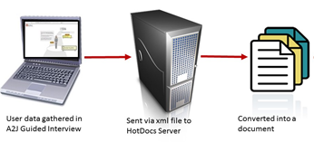
The Solution: Technology for Legal Aid
Statewide websites for legal information
SMS texting campaigns
Document Assembly

Slide 4
But then…
Legal Services Corporation’s Summit on the Use of Technology to Expand Access to Justice, Mission Statement: “...explore the potential of technology to move the United States towards providing service of some form to 100 percent of those persons with a legal need.”
Notes:
Now the goal is to provide everyone with something. So how do we ramp up our efforts? Let’s first talk about what we have been doing over the past 3 years , what the NY courts have been doing, and then we’ll talk about our future plans.

Slide 5
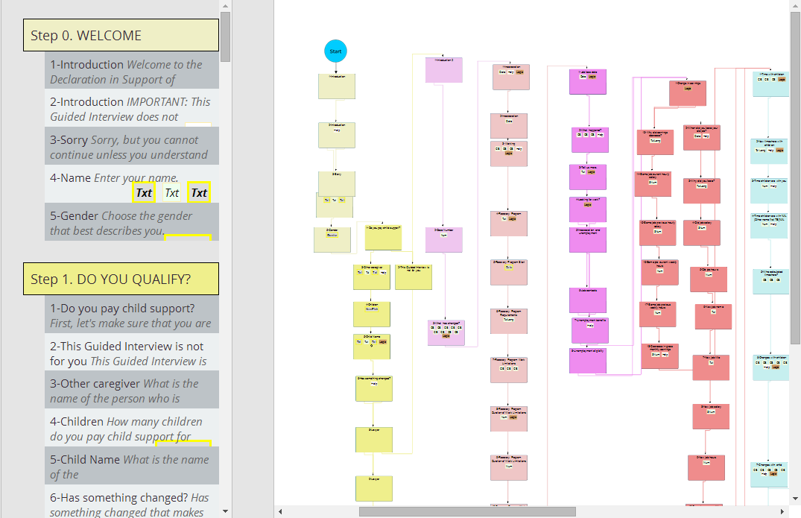
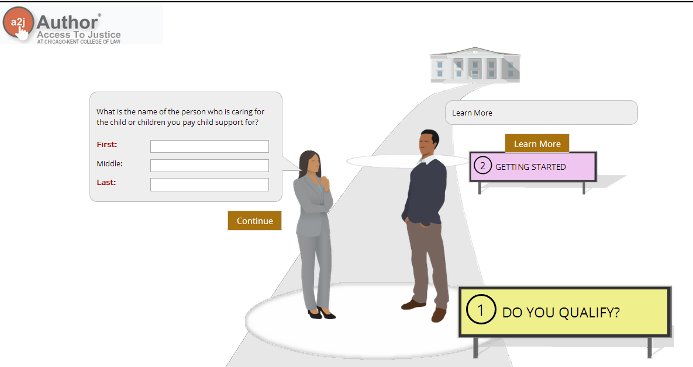
What is A2J Author?
Legal aid organizations, courts, and law schools use A2J Author to create “A2J Guided Interviews” to collect data from end-users one piece at a time.
Notes:
A graphical user interface for data collection specifically designed by Chicago-Kent & CALI for low-income, self-represented individuals.
It enables non-technical authors from legal aid providers, courts, and law schools to rapidly build and implement customer friendly web-based interfaces for document assembly.

Slide 6
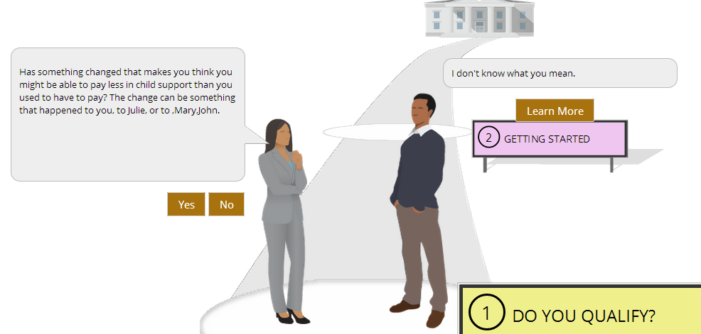
What is A2J Author?
A2J Author has “just in time” learning features for the end-user including: “Learn More” bubbles, definition pop-ups, audio, graphic and video capabilities.

Slide 7
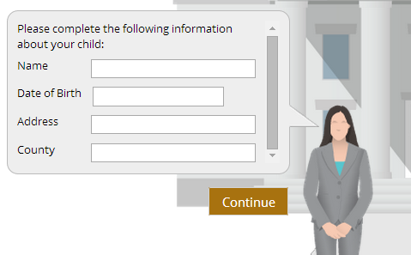
Uses for A2J Author: Document Assembly
Child name TE
Child DOB DA
Child address TE
A2J Author Answer File
Child county TE
John Doe
01/22/2006
123 My Street
OurCounty

Slide 8
Document Assembly

Slide 9
Other Uses for A2J Author
U.S. District Court for the Eastern District of Missouri
Notes:
Mention Triage and Online intake

Slide 10
A2J Guided Interviews
2,600,716
1,544,759

Slide 13
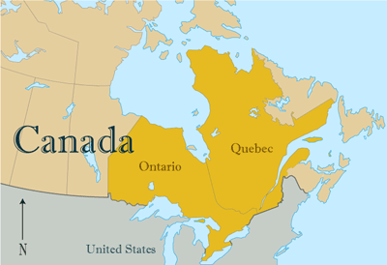
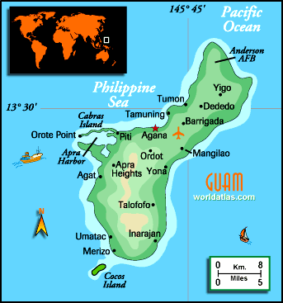
A2J Around the World

Slide 14
Another Problem, Another Solution
1-5 A2J Guided Interview developers per state at any given time
10,000 + forms that could be automated for pro se litigants
Approx. 40,000 new law students each year
Changing employment market for new grads
Notes:
Just passing the bar isn’t good enough anymore in new job market.

Slide 15
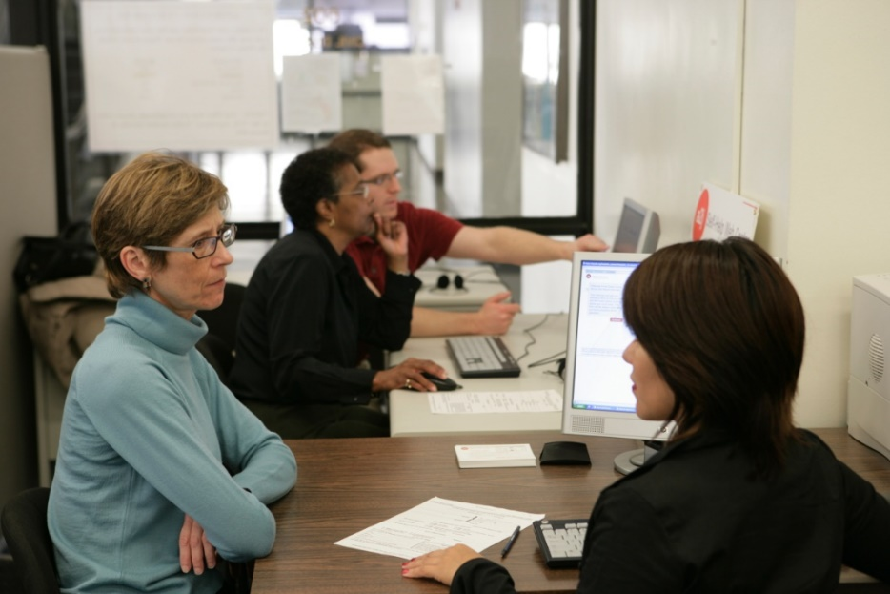
Justice & Technology Practicum
IIT Chicago-Kent College of Law
2010 – Present
Professor Ron Staudt
Law Student Tasks
Field Observation – Self-Help Web Desk
Scope Document
Research Memo
Storyboard
HotDocs Template
A2J Guided Interview
Final Report
Self-Help Web Desk

Slide 16
The Solution: The A2J Author Course Project
Technologically savvy law students create A2J Guided Interviews and HotDocs templates for resource strapped legal aid organizations
6 schools taught A2J courses as part of a pilot in 2013-14
University of North Carolina School of Law
Georgetown University Law Center
Columbia Law School
University of Miami School of Law
CUNY School of Law
Concordia University School of Law
Notes:
Based on a course created at Chicago-Kent – J&T Practicum

Slide 17
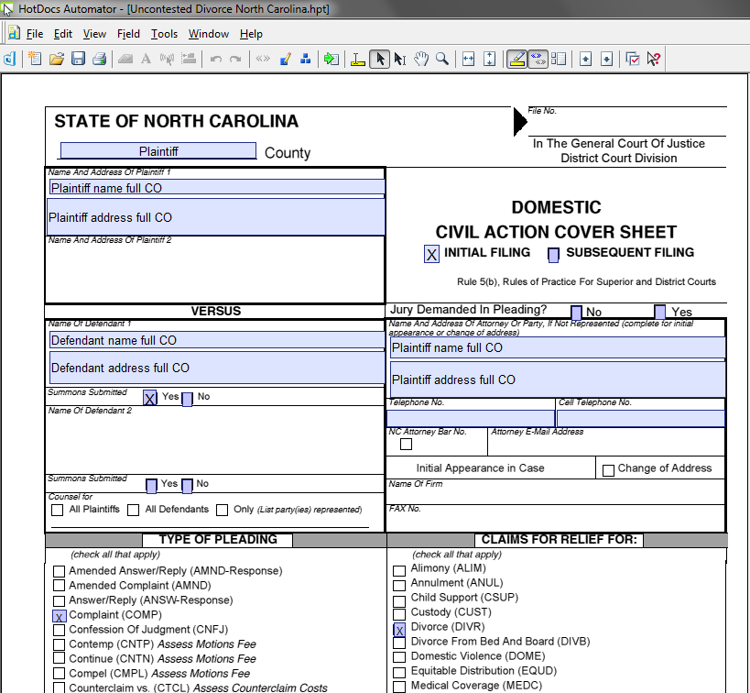
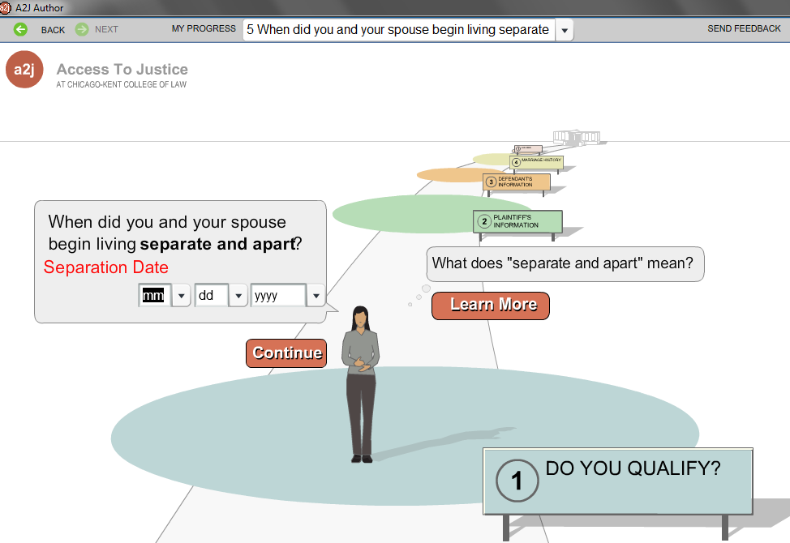
Sample Student Project: North Carolina’s Simple Uncontested Divorce
Notes:
28 questions in the A2J Guided Interview; a two student project
Explained legal terms, like living separate and apart; 5 qualification questions to ensure the form is being used by the correct people; advanced logic to help the end user along ( lived apart one year- instead of asking that, just ask for the date of separation and then used advanced conditions to calculate whether that is more than a year from today); explained rights that could be lost if this form is filed (alimony)
The HotDocs contained 9 pages, including the cover sheet, civil summons, certificate of service, judgment of divorce, and the divorce complaint. Everything you would need to file for divorce in North Carolina (with no children and no property)

Slide 18
Student Reactions
“Overall, this course exposed me to a unique blend of big ideas and technical skills.”
“Before I took this …I did not fully grasp the importance of technology in shaping the future of the legal profession.”
“I had never done any sort of programming before and it was fun to learn some of that stuff.”
“This class was completely different from any other law school class I have taken.”

Slide 19
Student Reactions
“I enjoyed learning how to use HotDocs and A2J Author, and was able to channel my passion for advocacy and public interest into a practical Guided Interview.”
“I found the class discussion about ethics interesting because it challenged us to determine where to draw the line between legal advice and information.”
“…challenged my own beliefs about the role of lawyers and the reality that lawyers are not always necessary for simple processes.”

Slide 20
Core Competencies
Ethnographic research
Project management
Law, rules, facts, heuristics
Empathy and plain language
Coding and transactional problem solving

Slide 21
A2J Author Course Kit
Rich collection of sample course materials from first round fellows
Listing of selected readings based on course topics
Choose materials based on course type and topics for instruction
eBook: http://a2jauthorcoursekitbook.lawbooks.cali.org/

Slide 22
White House Forum on Access to Justice April 14, 2015
Justice & Technology Practicum Alum Hanna Kaufman speaks about her experiences in the course.

Slide 23
Round 2 of A2J Author Course Project
Jennifer Gundlach, Maurice A. Deane School of Law at Hofstra
Alyson Carrel, Northwestern University School of Law
Carrie Hagan, Indiana University Robert H. McKinney School of Law
Rebecca Trammel, Stetson University College of Law
Rob Blitt & Val Vojdik, University of Tennessee College of Law
Michael Robak, UMKC School of Law

Slide 24
A2J Implementation
First year law students
Develop and staff a pro bono court watch/observation program in which 1Ls could participate, get feedback from court staff and offer insight into current practices and thoughts on what is needed in identified courts
Second and Third year Clinic Students
Use A2J guided interviews for client needs, identifying gaps in assistance for future interviews
Evening Students
Develop and use A2J guided interviews for specific partner and workplace identified pro bono/self represented litigant needs
Social Work MSW Students
Objectively test developed interviews and adding in missing resource information. Develop intake and assessment sheets or both the clinic and non-profit partners

Slide 25
A2J Implementation in the FA2015 Civil Practice Clinic
Fall 2015:
Offer two sections of the Civil Practice Clinic
One to be normally litigation, case and client focused, offered to both evening and day students as schedules permit
One to be A2J project focused, with client interaction via community partner assistance, offered to evening students only
Students will be paired on the identified A2J projects
Students will present any final product to both sections of the clinic and our community partners
Both sections will be required to be present at the main Saturday of orientation

Slide 26
A2J Implementation in the SP2016 Interdisciplinary Civil Practice Clinic
Spring 2016:
Offer one section of the Civil Practice Clinic
Eight 2L and 3L law students paired alongside 8 MSW students
All students to test and refine already developed guided interviews from FA2015
Law students to both use guided interviews and issue spot for future needs with community partners
MSWs to develop clinic intake and assessment forms

Slide 27
A2J Author Resources
A2J Author Website: http://a2jauthor.org
A2J Author Course Project Classcaster Site
http://a2jclinic.classcaster.net
A2J Author YouTube Channel
https://www.youtube.com/user/A2JAuthor
Monthly New User Webinars
Follow us on Twitter!
@a2jauthor

Slide 28
Contact
Jessica Bolack Frank
IIT Chicago-Kent College of Law
jbolack@kentlaw.iit.edu
Alexander Rabanal
IIT Chicago-Kent College of Law
arabanal@kentlaw.iit.edu
Carrie Hagan
Indiana University Robert H. McKinney School of Law
chagangr@iupui.edu

