Slide 1
How to Create a Distance Education Course
Deb Quentel
Director of Curriculum Development & General Counsel
CALI
Email: dquentel@cali.org
Twitter: @DebQuentel
CALI Conference for Law School Computing® June 13, 2013

Slide 2
Why this Topic
I am passionate about it.
Experience with online classes
Topic of growing importance in law school

Slide 3
What I’m Covering & Skipping
Covering
Distance Education
ABA Standards
Creating an online course
Thinking about teaching pedagogy
Online LLM programs
Skipping
Flipped classrooms – please attend other sessions

Slide 4
Distance Education Defined
“distance education is teaching and planned learning in which teaching normally occurs in a different place from learning, requiring communication through technologies as well as special institutional organization.”
Synchronous or asynchronous
Moore & Kearsley, Distance Education: A Systems View of Online Learning, p.2 (2012)

Slide 5
ABA Defines Distance Education
Standard 306. DISTANCE EDUCATION
(b) Distance education is an educational process characterized by the separation, in time or place, between instructor and student. It includes courses offered principally by means of:
(1) technological transmission, including Internet, open broadcast, closed circuit, cable, microwave, or satellite transmission;
(2) audio or computer conferencing;
(3) video cassettes or discs; or
(4) correspondence.
http://www.americanbar.org/content/dam/aba/publications/misc/legal_education/Standards/chapter_3_2012_2013_aba_standards_and_rules.authcheckdam.pdf

Slide 6
ABA Standard 306
Standard 306. DISTANCE EDUCATION
(c) A law school may award credit for distance education and may count that credit toward the 45,000 minutes of instruction required by Standard 304(b) if:
(1) there is ample interaction with the instructor and other students both inside and outside the formal structure of the course throughout its duration; and
(2) there is ample monitoring of student effort and accomplishment as the course progresses.

Slide 7
Should your law school move any JD classes online?
Three commons problems in introducing distance education to any institution:
Academic culture of teaching
“The Way we Were”
We do it differently

Slide 8
Should your law school move any or more JD classes online?
“If everyone jumped off the Empire State Building…?”
Is the administration behind this decision?
Are faculty interested in teaching online?
Who will own the course?
Why are you moving courses online?

Slide 9
How do we move a class online?
Planning
Content
Sequence and structure
Media
Teaching strategies
Interactions
Evaluation
Creating the materials

Slide 10
Implementing the Planning Process
ADDIE
Analysis
Design
Development
Implement
Evaluate

Slide 11
Implementing the Planning Process
ADDIE – a example of the Analysis phase
Design of the course
Audience
Goal
Objectives
Identify Content
Instructional Strategies

Slide 12
Merrill’s First Principles of Instruction
Task-Problem
Activation
Demonstration
Application
Integration

Slide 13
Using Merrill to Determine Whether a Work is in the Public Domain
Problem
Set the stage for the problem, and
Define it

Slide 14
Using Merrill to Determine Whether a Work is in the Public Domain
1. Task

Slide 15
Using Merrill to Determine Whether a Work is in the Public Domain
2. Activation

Slide 16
Using Merrill to Determine Whether a Work is in the Public Domain
3. Demonstration

Slide 17
Using Merrill to Determine Whether a Work is in the Public Domain
4. Application

Slide 18
Using Merrill to Determine Whether a Work is in the Public Domain
5. Integration

Slide 19
Gagne Nine Events of Instruction
Gain Attention
Inform Learners of Objectives
Stimulate recall of prior learning
Present the Content
Providing “learning guidance”
Elicit performance (practice)
Provide Feedback
Assess Performance
Enhance retention and transfer to the job

Slide 20
Who Does this Planning and Development?
Single faculty member
Author-editor
Course team

Slide 21
Lights, Camera, Action
Video alone won’t satisfy the ABA Standard 306
Video alone lacks
“ample interaction with the instructor
and other students
both inside and outside the formal structure”
ABA Standard 306 (c)(1)
“ample monitoring of student effort and accomplishment as the course progresses
ABA Standard 306(c)(2)

Slide 22
Distance Education Past & Future
Early distance learning courses were based on instructivist approach to teaching
Trend is towards….
Constructivist Theory – learner centered and collaborative

Slide 23
How do we Construct an Effective Distance Education Course for our Students?
Transactional Distance
Dialogue
Structure

Slide 24
Why do we care about Transactional Distance?
Greater
Transactional
Distance
More Learner
Responsibility
Required

Slide 25
Types of Transactional Interactions
Student-Content
Student-Student
Student-Interface
Student-Professor

Slide 26
Types of Transactional Interactions
Student-Content
Student-Student
Student-Professor

Slide 27
Designing Student Participation
How will it be engineered?
Threaded email
Audio / Video Conference calls
Google Hangouts, Skype
Shared documents
Wiki, Google docs
Collaborative student projects

Slide 28
What else would work?
“Sage on the stage”
Use 2 speakers
Involve the students –
Chinese Proverb: Tell me, I forget. Show me, I remember. Involve me, I understand.

Slide 29
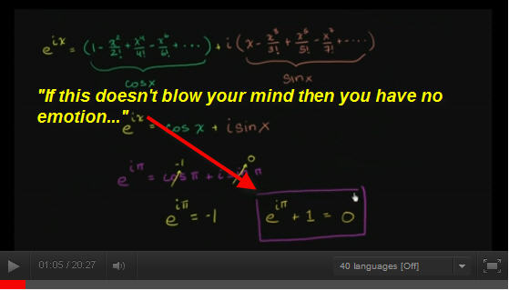
Sometimes Video is Perfect
You’re called out of town for single class
Guest speaker can’t come to class – and isn’t available for synchronous event
TED talks

Slide 30
Tools to Use
LMS that is already used by main campus
Classcaster
Video
Podcasting
Other tools
Wiki
Word Press blog
Threaded email
Photo Story
Shared documents

Slide 31
Does your law School offer an LLM?

Slide 32
Hypothetical Law School

Slide 35
Alternatives

Slide 36
Alternatives

Slide 37
Alternatives

Slide 38
Why not offer an LLM
Low employment – gives students additional experience
Allows for students to re-tool for expertise that is in more demand – notice how many LLM programs are a specialty (health law, Tax, entertainment, family….)
Faculty may be underutilized

Slide 39
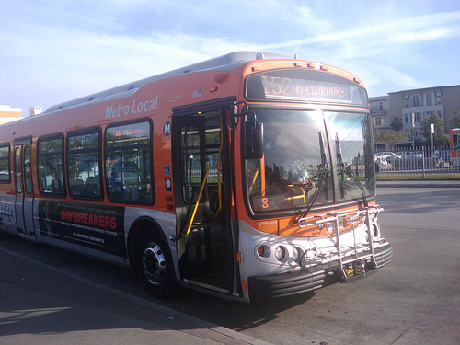

Slide 40
- http://earthobservatory.nasa.gov/IOTD/view.php?id=885

Slide 41
Reasons to offer your LLM online
Broader student body applicant pool
Adds diversity
Avoids crowding of physical space
Broadens your alumni base
More contacts for job possibilities
Diversifies your donation pool
Expands the reach of your “brand”

Slide 42
Questions and Comments

