Slide 1
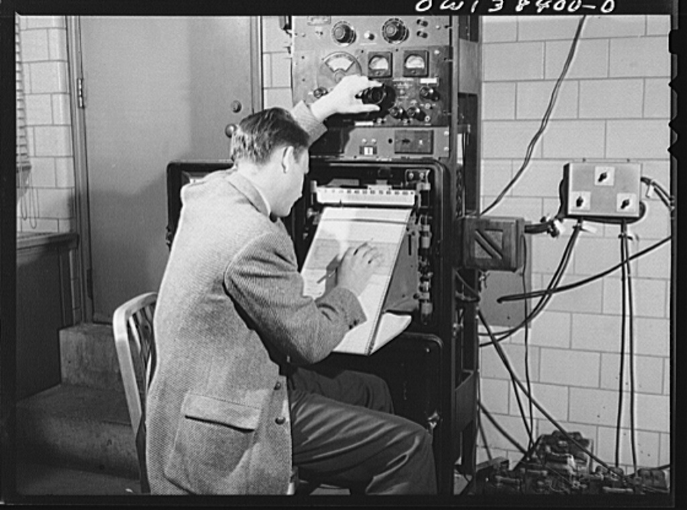
Finding + Tuning
Social Signals
Marcia Dority Baker, University of Nebraska – Lincoln
Roger V. Skalbeck, Georgetown Law Library
Notes:
http://memory.loc.gov/service/pnp/fsa/8d40000/8d40700/8d40768v.jpg

Slide 2
NOISENOISENOISENOISENOISENOISENOISENOISENOISENOISENOISENOISENOISENOISENOISENOISENOISENOISENOISENOISENOISENOISENOISENOISENOISENOISEN
NOISENOISENOISENOISENOISENOISENOISENOISENGISENOISENOISENOISENOISENOISENOISENOISAOISENOISENOISENOISLNOISENOISENOISENOISENOISENOISENO
Notes:
The trick is to find sources where you can ‘tune’ the amount of signals coming to the end user.
Either do this with user controls (hide these updates), or pre-publication filters (selective controls at the network level).

Slide 4
Social Media Network Links
on Law School Home Pages: 2012
Facebook: 164
Twitter: 144
Flickr: 40
Google Plus: 12
Vimeo: 10
Foursquare: 5
Goodreads: 2
Pinterest: 2
Delicious.com: 1
Instagram: 0

Slide 5
Institutional Blogs Suck
Institutional Blogs Suck Struggle for Sustainability
* Also: Facebook Pages, Google+ Sites, Twitter Accounts, Pinterest, Vine Videos, Delicious bookmarks, etc.
Notes:
U. Chicago + Georgetown = BAD EXAMPLES

Slide 6
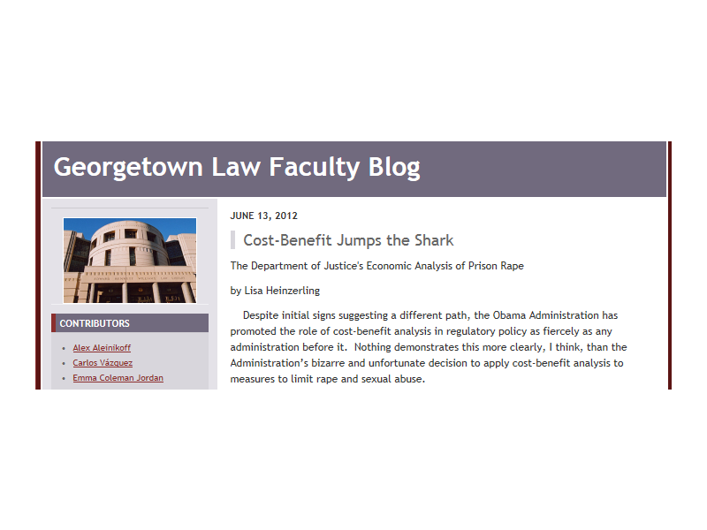
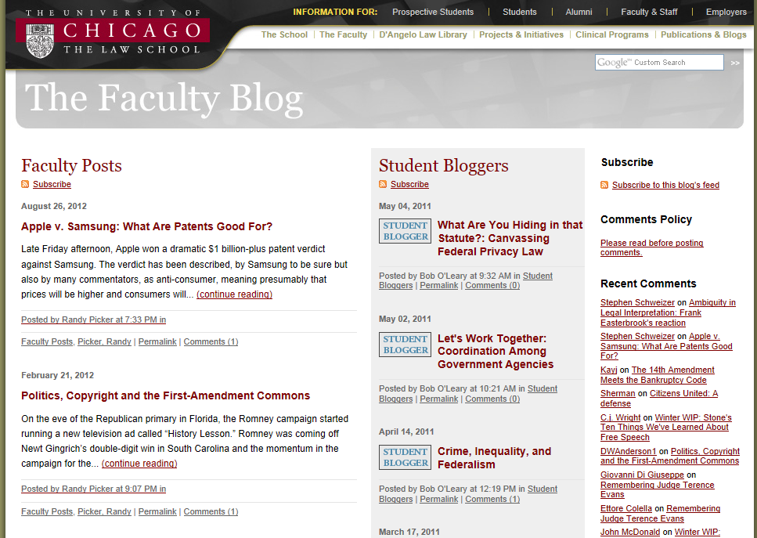
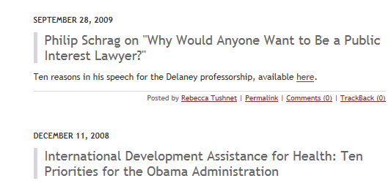
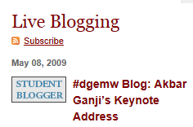
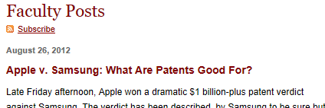

Slide 7
Problem: Professors blog elsewhere.
Often. With other authors
Solution: Capture Existing Content.
Filter. Package. Publish.
Notes:
It’s not that faculty are not blogging. It’s that they’re not blogging “for the team”
Many faculty write other places. Often. With others.

Slide 8
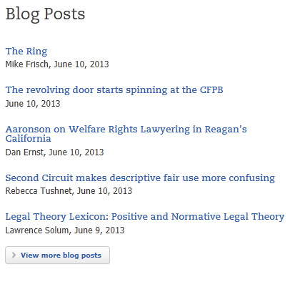
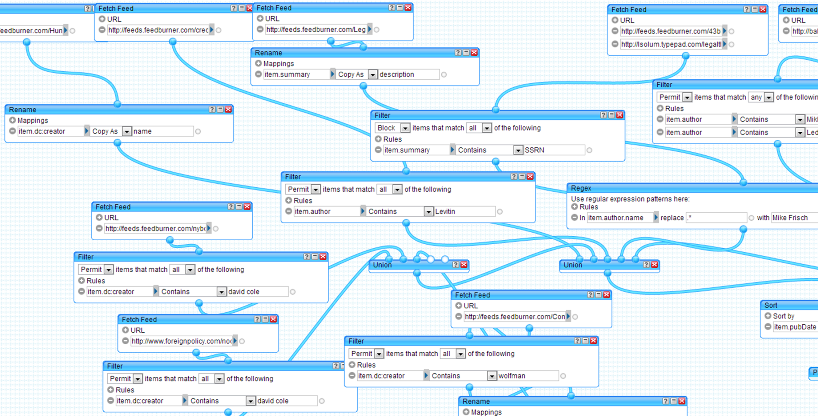
14 Authors; > 1 dozen blogs
www.law.georgetown.edu/faculty/blogPosts.cfm
Notes:
http://pipes.yahoo.com
Filter by: Author name; Add: Byline; Filter some post types
Next slide: Marcia + cats

Slide 9
Time vs. Value
Social software is free like a free
What is the end goal?
Why use a particular platform?
Set-up (time) + maintenance (time) = Worth it?
Notes:
Social software is like a free kitten, it’s more than signing up for a free product. Questions to ponder before starting w/a new platform:
What is the goal for using this platform? What is the library trying to accomplish?
Who is responsible for setup, review & evaluation of platform?
How long will library participate? Free trial, short term project (1 yr, review monthly), long term (sign contract, review annually)
Communication: who will promote, how will people know that library is using platform?

Slide 10
Twitter Feed Cascade
Organize relevant Tweets as online newspaper
Daily edition = always collecting & sharing
Initial setup & tweaking, then autopilot
Notes:
What: a free project that will gather & sort content from Twitter, Facebook, Google+ and the web into a daily newspaper.
How: sign up/register for an account; add relevant Twitter feeds (15 for free account) to set up newspaper. Users can subscribe to newspaper(s) and receive daily email notice of new issue.
Why: good way to synthesis the content of Twitter account and follower’s tweets on regular basis. Can be used to review trends, popular stories or news as well as photos, video and headlines.
End Result: this is a great resource for turning online bits of information into manageable newspaper format.

Slide 11
All the News that’s Fit to Tweet?
Notes:
http://paper.li/schmidlibrary/1360182652

Slide 12
Platforms:
Twitter
Facebook
LinkedIn
Google+ (sort of)
RSS
Instagram
Storify
YouTube
Vimeo
Etc.
Track:
Twitter Lists
Search Terms
Activity Streams
Hashtags
Twitter DM
Features:
Scheduled Posts
Multi-platform publish
RSS to publish
Metrics & Reports
Notes:
Log in to show a quick demo at: http://www.hootsuite.com

Slide 13
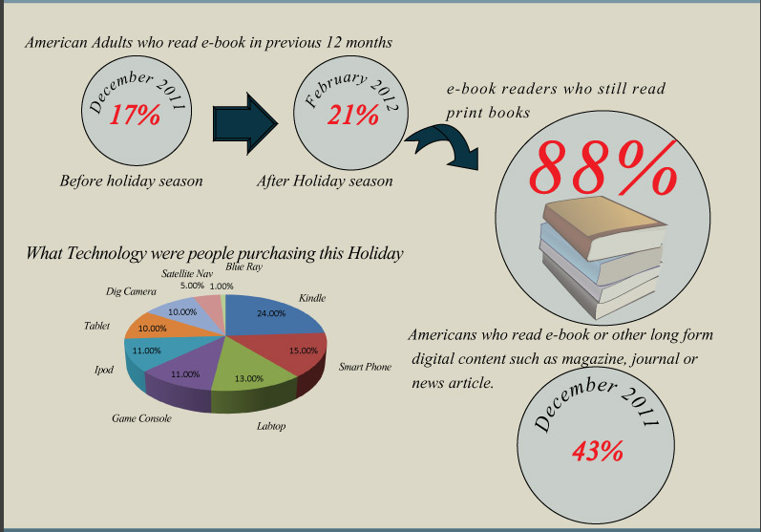
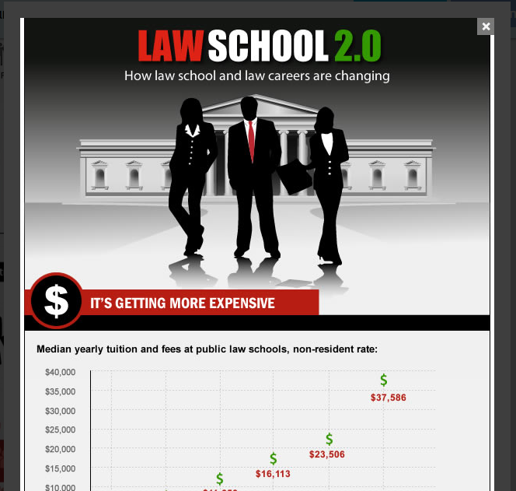
Data as Art
Notes:
Visual.ly inforgraphics
A picture is worth a 1000 words.
E-books & libraries: http://visual.ly/reading-america
Law School 2.0: http://visual.ly/law-school-20
What: use infographics to visually present data.
How: sign up/register for an account; create your own infographic from data or use other infographics to share information in an eye-catching way.
Why: data can be boring and hard to interpret, this resource allows user to create and present relevant data in an appealing format that can be embedded in a variety of platforms.
End Result: cool looking data – what more can librarians ask for?

Slide 14
Visual.ly in “Digital Assets in Estate Planning” LibGuide
Notes:
http://schmidguides.unl.edu/content.php?pid=461470

Slide 15
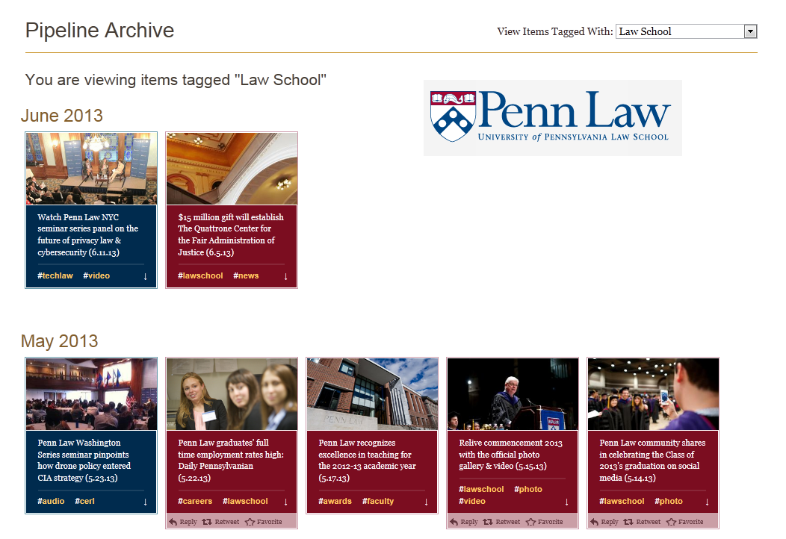
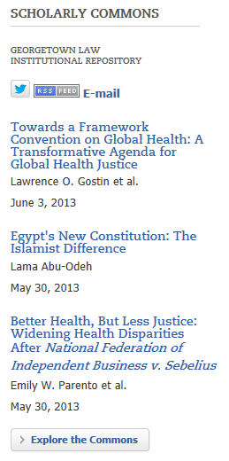
Example #1: www.law.georgetown.edu/faculty/
Example #2: www.law.upenn.edu
Notes:
www.law.georgetown.edu/faculty/
www.law.upenn.edu

Slide 16
Tumblr in the Library?
Micro-blogging + Social Software = Tumblr
What law libraries using it?
#lawlibraries or #lawlibrary
Notes:
One example: http://hoyas2013.tumblr.com/
Nebraska Law http://www.nebraskalaw.tumblr.com/ & Law of Secrecy tumblr by asst dean on trending whistleblowig http://lawofsecrecy.tumblr.com/
What: microblogging platform for posting anything from anywhere.
How: signup/register for an account; users can post content such as; text, photos, links, music & video from any device.
Why: this resource is a quick and trendy way to post content from a variety of formats in one place.
End Result: some Tumblrs are very creative with a large number of followers (Dr. Who), others have a wicked sense of humor towards a particular situation (law school).

Slide 17
Law School Tumblr = Dark Humor & GIFs
Notes:
Nebraska Law using Tumblr http://nebraskalaw.tumblr.com/
Law Schools tagged in Tumblr http://www.tumblr.com/tagged/law%20library
Penn Law has old tumblr account, not updated in a year!

Slide 18
Tell a Story…
Notes:
https://storify.com/
What: use web content to tell a story.
How: sign up/register for an account; use your social networks to curate material to create stories on specific topics.
Why: this resources allows users to filter through web content from Twitter, Facebook, YouTube, Flickr, Instagram and more to collect and share specific information with other users.
End Result: A unique way to gather and present web content for research on a specific topic or to organize information for information gathering needs.

Slide 19
Storify for Research
Notes:
From Slaw: http://tips.slaw.ca/2013/research/use-storify-to-save-and-send/
AALL12 conference Reports: http://storify.com/kimnayyer/law-libraries-and-open-government
How Twitter is changing storytelling: http://www.fastcoexist.com/1682122/how-twitter-is-reshaping-the-future-of-storytelling

Slide 21
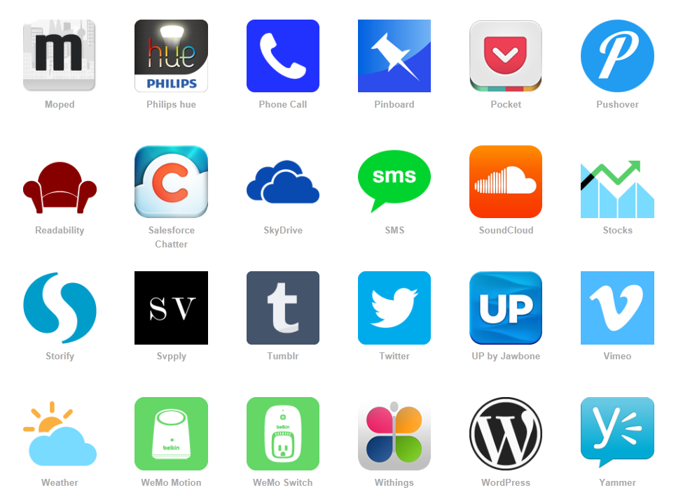
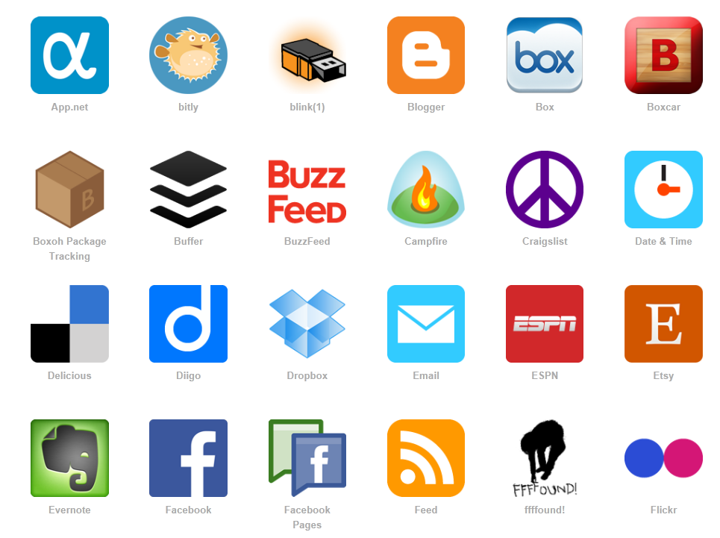

Slide 22
Twitter
Archiving / Capture / Analysis
SearchHash
TweetArchivist
Twitter Archiving Google Spreadsheet (TAGS)
ThinkUp App
Notes:
http://mashe.hawksey.info/2013/02/twitter-archive-tagsv5/

Slide 23
Questions?
Tips?
Marcia Dority Baker, University of Nebraska – Lincoln
Roger V. Skalbeck, Georgetown Law Library
Notes:
http://memory.loc.gov/service/pnp/fsa/8d40000/8d40700/8d40768v.jpg

Slide 24
What Else?
Trello: project management system http://trello.com
Twivo: anti-spoiler for Twitterhttp://www.indiewire.com/article/a-17-year-old-girl-creates-twivo-a-program-to-save-the-world-from-twitter-tv-spoilers
Twitter list
Pinterest
Social media policy?
Storify by Chicago-Kent http://storify.com/ChicagoKentLaw
Notes:
Audience discussion & suggestions of cool resources.

