Slide 1
Analytics to Find Opportunities or What Google can tell you about your users and yourself
Wayne Weibel
Interface / Web / Drupal Developer
Legal Information Institute
Cornell University
Dan Blackaby
Technology Services Librarian
Cornell University Law Library
Notes:
Poll audience for analytics use, code experience, code access

Slide 2
Google Analytics
provides user tracking, layout experimentation, and site performance metrics
uses asynchronous scripting to inject code and record data
tracks users/visits via cookies
Notes:
A/B testing of pages (no more multi-variant), can get unruly – LII donation form.
Users tracked during each page view/event – information from the http request, browser data, cookies
- No personal identifying information

Slide 3
Google Analytics
provides user tracking, layout experimentation, and site performance metrics
uses asynchronous scripting to inject code and record data
tracks users/visits via cookies
improve site traffic
improve design and layout
Notes:
Increase or guide traffic where ya want, via improved design/layout, or via ‘campaigns’

Slide 4
Google Analytics
provides user tracking, layout experimentation, and site performance metrics
uses asynchronous scripting to inject code and record data
tracks users/visits via cookies
improve site traffic
improve design and layout
keep users on the site … yes, analytics is all about marketing
Notes:
A site is a resource, keep users coming back, keep them there. More users/traffic ==better resource == more linking == higher seo, rinse and repeat

Slide 5
What ya need is
a Google Account
access to the code (of the webpage)
Notes:
Code == webpage markup or template code (or other generation code)
That’s it and even #2 is not really a necessity if ya have someone that can do it for you
HTML for bare minimum, will need to know (a liitle) javascript/jquery for more advanced tracking

Slide 6
What ya need is
a Google Account
access to the code (of the webpage) … yeah that’s it
Notes:
Code == webpage markup or template code (or other generation code)
That’s it and even #2 is not really a necessity if ya have someone that can do it for you
HTML for bare minimum, will need to know (a little) javascript/jquery for more advanced tracking

Slide 7
What ya need is
a Google Account
access to the code
an Analytics account is NOT the same as your Google account
users must have a valid gmail
Analytics
Notes:
An account is like a semipublic dropbox folder, season tickets, or time share, not dedicated to a single person
Account == property, property is the website you ‘possess’, could have multiple properties per account
Each property has a separate tracking code (will talk about later)
1 to many properties to profile – each profile has a separate user base, each account can have different users, with different permissions
Law school vs law library – separate accounts or profiles

Slide 8
Notes:
Creating an analytics account/property
- first account automatically guides through first property
- Adding user; different per profile vs account

Slide 9
Tracking Code
Old-old way was not asynchronous
Notes:
Loading of analytics slowed loading of the page, very bad, should not be used, ever
Any code examples for such should be ignored … moving on
Lots of variation in help center and documentation

Slide 10
Tracking Code
Old-old way was not asynchronous
New-old way – ga.js
Notes:
Analytics support shows code for ga.js … googling analytics gives snippets for ga.js – standard for the past several years

Slide 11
Tracking Code
Old-old way was not asynchronous
New-old way – ga.js
New-new way – analytics.js – Universal Analytics
Notes:
Analytics support shows code for ga.js … googling analytics gives snippets for ga.js
Analytics.js only guide is in the developers documentation
New-New way is only the past several months; universal analytics tracks visitors (ga.js tracked visits); universal you set timeouts for session and campaign
Universal Analytics is now default

Slide 12
Tracking Code
Put in each page directly … yeah no
Notes:
Just don’t do it, unless you only have a handful of pages that will not change regularly

Slide 13
Tracking Code
Put in each page directly … yeah no
Dynamic include; PHP or Javascript
<?php include_once(‘path/to/file/analyticstracking.php’); ?>
<script type="text/javascript" src=”path/to/js/analyticstracking.js” />
Notes:
Analytics suggests a PHP file with the script tag within it, as html. Really can do it however ya want.
Still need to put ‘tags’ into each page

Slide 14
Tracking Code
Put in each page directly … yeah no
Dynamic include; PHP or Javascript
<?php include_once(‘path/to/file/analyticstracking.php’); ?>
<script type="text/javascript" src=”path/to/js/analyticstracking.js” />
Theme Template include
directly insert tracking <script>, or use a dynamic include
Put in module/plugin code
Notes:
theme include: xxx.tpl.php (drupal) | header.php (wordpress)
module/plugin code: hook_init (drupal 6) | .info file (drupal 7) | add_action(‘wp_head’, …) (wordpress)

Slide 15
Notes:
Show and describe actual code for template and drupal module, D6 and D7
Cross domain – ga.js == need ‘setDomain’ even for subdomain (option in analytics property tracking tab); analytics.js == subdomain baked in, but still need for true x-domain
- jQuery code to ‘bug’ the links so ya don’t have to change em all
- full document click tracking
Cross domain:
ga.js property != subdomain, must do setDomain in tracking script
analytics.js subdomain baked in
must ‘allow linker’
must still ‘bug’ links’ for all other domains

Slide 16
Real World Examples
LII - Second Amendment
LII - Federal Rules of Bankruptcy Procedure
Notes:
second amendment link called “Annotated Constitution” before; moved behind tab; link name change 3% => 35% click
FRBP – breadcrumb link clicked even though on same page; added comment about lawyer resource, link to wex article
- 15% of users, 50% CTR
- users cut in half; number still clicking breadcrumb + new link nearly equals prior amount

Slide 17
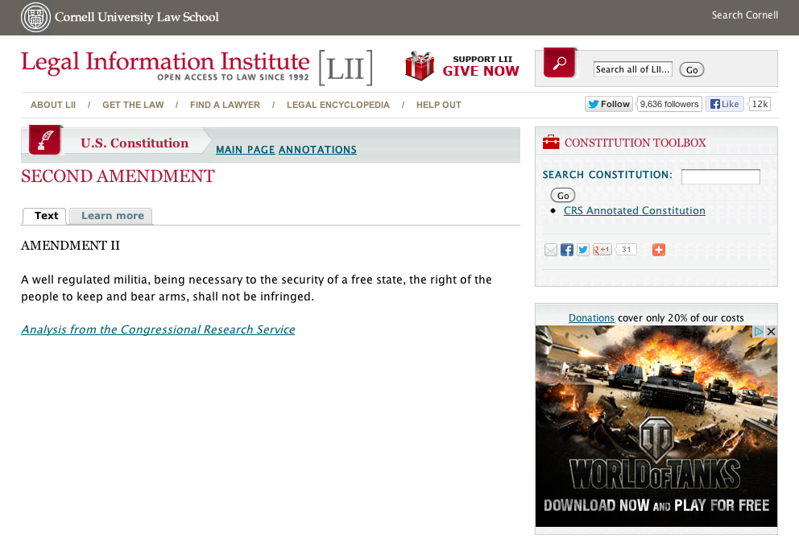
Notes:
second amendment link called “Annotated Constitution” before; moved behind tab; link name change 3% => 35% click
FRBP – breadcrumb link clicked even though on same page; added comment about lawyer resource, link to wex article
- 15% of users, 50% CTR
- users cut in half; number still clicking breadcrumb + new link nearly equals prior amount

Slide 18
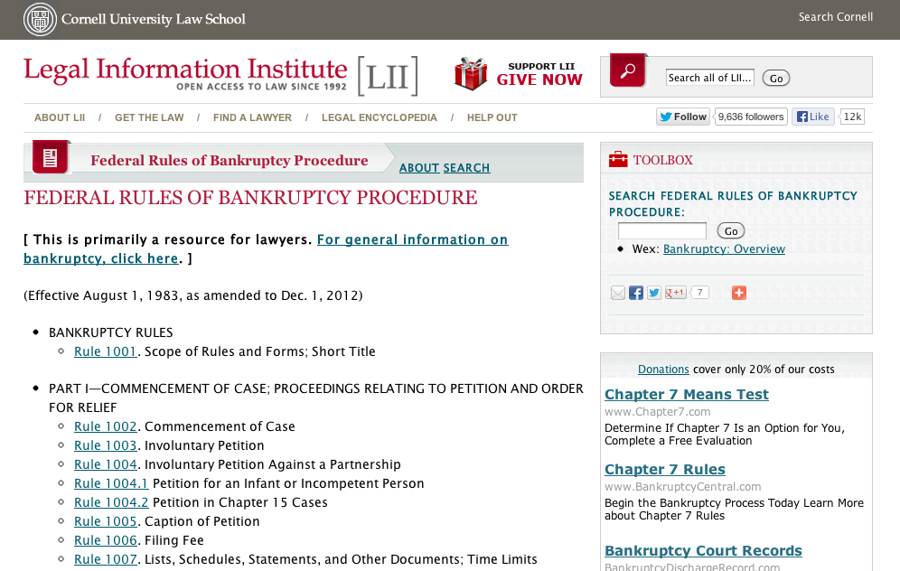
Notes:
second amendment link called “Annotated Constitution” before; moved behind tab; link name change 3% => 35% click
FRBP – breadcrumb link clicked even though on same page; added comment about lawyer resource, link to wex article
- 15% of users, 50% CTR
- users cut in half; number still clicking breadcrumb + new link nearly equals prior amount

Slide 19
Real World Examples
LII - Second Amendment
Resource link pulled from behind tab
Name of link changed => 3% to 35% click
LII - Federal Rules of Bankruptcy Procedure
High click rate on link to itself in breadcrumb
Put note about lawyer resource
Browser Window vs. Screen Size ‘event’
Notes:
‘event’ tracking similar to cross domain tracking; send/queue event message to analytics
See what size people are really viewing page; landscape vs. portrait

Slide 20
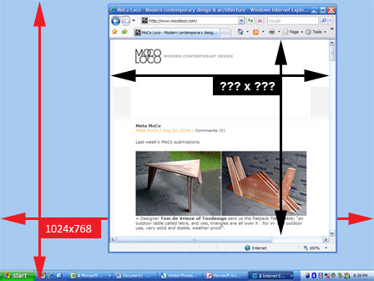

Slide 21
Real World Examples
LII - Second Amendment
Resource link pulled from behind tab
Name of link changed => 3% to 35% click
LII - Federal Rules of Bankruptcy Procedure
High click rate on link to itself in breadcrumb
Put note about lawyer resource
Browser Window vs. Screen Size ‘event’
_gaq.push(['_trackEvent’, ‘viewport’, 'width’, $(window).width()+’’]);
_gaq.push(['_trackEvent', ‘viewport’, 'height', $(window).height()+’’]);
Rutgers Law Library Hours
Measurement Protocol
Notes:
Real world event, tracked in Google analytics
Need: protocol version (currently always 1), property id, event type, client/user id
Reference / Circulation desk questions, emails, phone calls, or even the collections/topics being used

Slide 22
Using Analytics During a Re-Design
A.K.A. Tweaking as you go

Slide 23
Assessment
Benchmarking
Realism

Slide 24
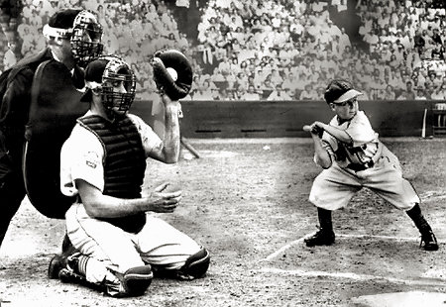
Notes:
Assessment – Are you in the situation you think you are? Do you have the right tools for the job? Is your site doing what it needs to be doing?

Slide 25
Notes:
Even if you have all the necessary info, you can still package it in a way that actually distracts from your purpose, or essentially adds nothing.

Slide 27
Notes:
In other words, is your site as effective as it can be? You think your site is this guy. Or you want it to be. Maximum output. Minimal effort. Content –your mileage may vary.

Slide 28
Notes:
Turns out you might be this guy. Lot of effort, but things aren’t quite as you’d like them.

Slide 29
Notes:
First --- think of your audience and what it actually needs. What parts of your site are getting traffic? How long are they staying? How are they accessing it?

Slide 30
The enemy of art is the absence of limitations -Orson Welles
Notes:
When you’re doing your redesign, it’s good to be aspirational. Say you want to drive mobile traffic, it’s good to do a responsive design. This is a measurable metric under Google Analytics.

Slide 31
I’ve never kept a record of anything
- Sean Connery
Notes:
Don’t do something just because you can. Is there a need, or do you want there to be a need?

Slide 32
Notes:
LONELINESS
Are your pages dying all sad and lonely like the English Patient’s girlfriend?

Slide 33
Notes:
Do you have any DAVID CARUSO pages?
(Pages that need to be spun-off to their own glamorous Miami destination to where they can wear white pants and take off their sunglasses off in cool ways while saying pithy scene-capping lines).

Slide 34
Notes:
Re-assess through usability testing during the process. You can change your mind.

Slide 35
Notes:
Remember why you’re doing it.

Slide 36
Notes:
Real Time
Content
Locations
Sources
Content
In-Page analytics (use Chrome)
rules/frbp and constitution/second_amendment
Site Speed – Page Timings
Site Content – Landing Pages
Audience
any / all of them
Traffic Sources
Sources – All

