Slide 1
Law Schools and the Free Law Movement
Sarah Glassmeyer JD MLS
Director of Content Development
Center for Computer Assisted Legal Instruction
@sglassmeyer / sarah@cali.org

Slide 2
1. Is your law school library open to the public?
Yes?
No?

Slide 3
2. Does your law school provide free digital copies of primary law on the Internet?
Yes?
No?

Slide 4
Why don’t these numbers match?
The second one should CAN be 100% yes.

Slide 5
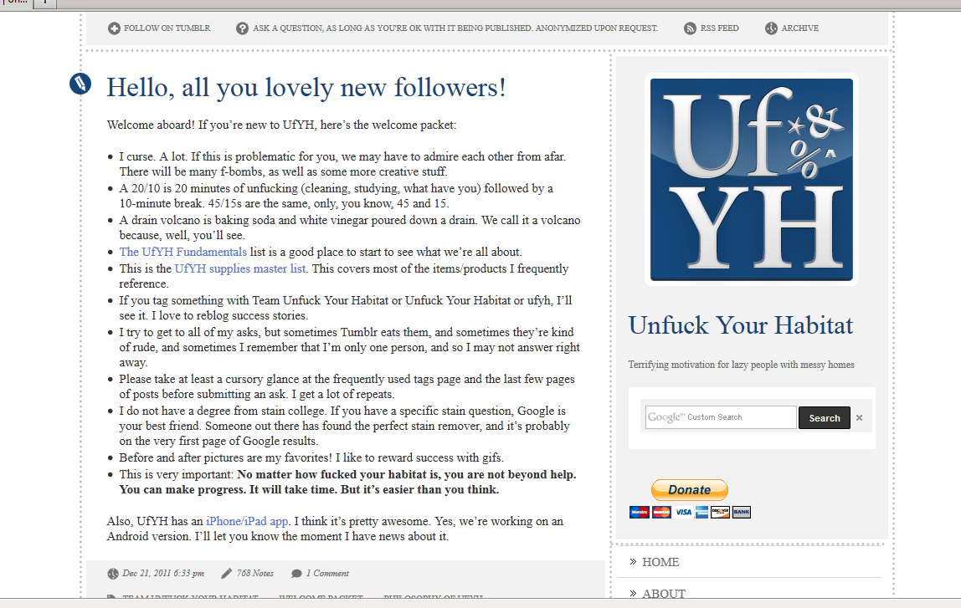
http://unfuckyourhabitat.tumblr.com/

Slide 6
No matter how fucked your habitat is, you are not beyond help. You can make progress. It will take time. But it’s easier than you think.

Slide 7
Let’s UnFuck Our Lex Corpus!

Slide 8
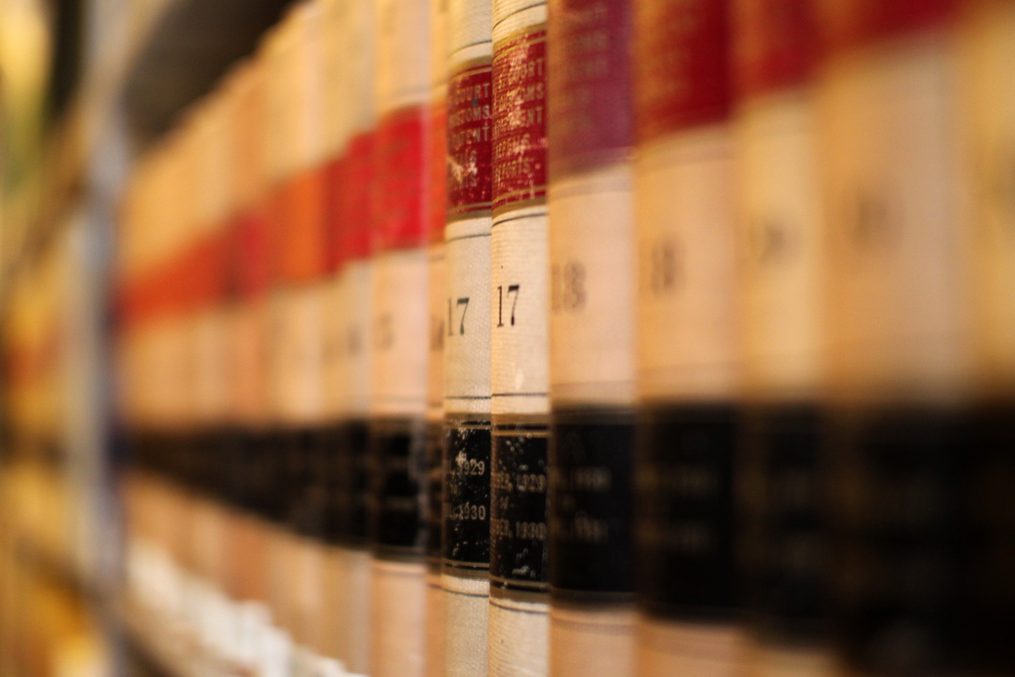
What is Free Law?
Image CC BY-ND-NC http://www.flickr.com/photos/mr_t_in_dc/

Slide 9
http://www.fatlm.org/

Slide 10
Declaration on Free
Access to Law
aka Montreal Declaration
tl:dr –
People have a right to access the law and it’s a good thing when they do

Slide 11
Image CC BY http://www.flickr.com/photos/virtualsugar/
Notes:
Open and Free not synonymous. Open is a pretty big commitment.

Slide 12
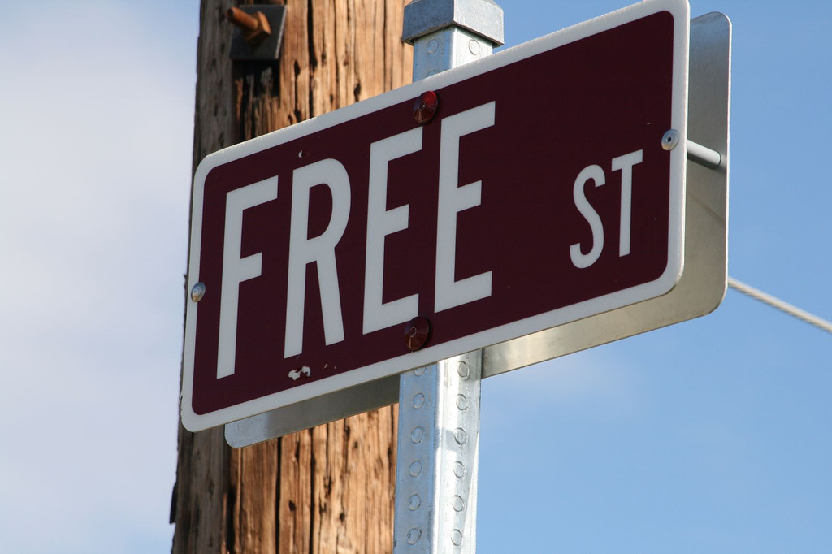
Image CC BY-NC-ND http://www.flickr.com/photos/cc_chapman/
Notes:
Free but with some extras, like subject organization, metadata, better formats or variety

Slide 13
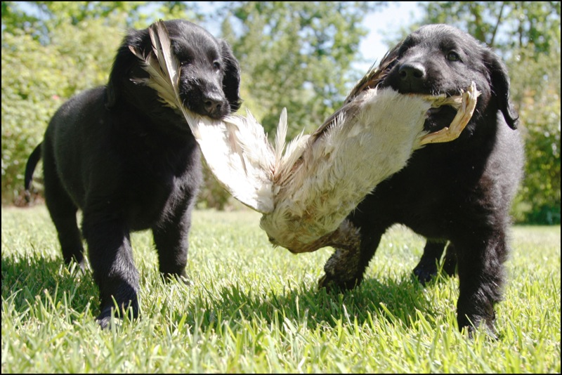
Image CC BY-NC-ND http://www.flickr.com/photos/xanboozled/
Notes:
Just do it, and we’ll figure it out later.

Slide 14
Image CC BY-NC-ND http://www.flickr.com/photos/quiltingmick/
Notes:
Best Practices

Slide 15
Why Do Free Law?
Image CC BY-ND-NC http://www.flickr.com/photos/mr_t_in_dc/

Slide 16
Public Service
Tax payer supported institution?
Justice Gap
Value Add of Legal Knowledge and Organization
Alleviate library budget crunches
Law School Crisis
(Did anyone get BINGO?)
Provide value to alumni
Skills training/Student Job opportunities for law students

Slide 17
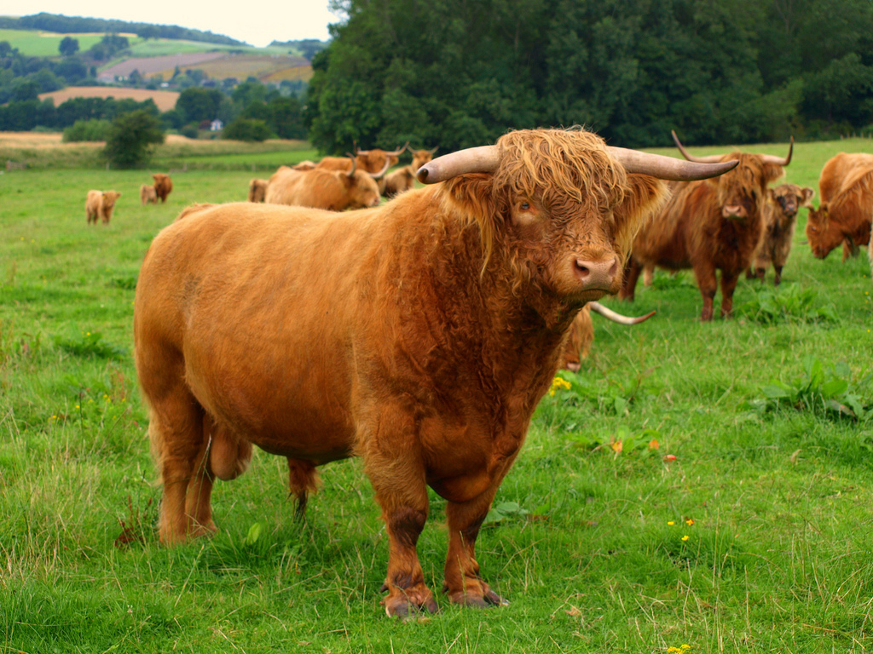
Image CC BY-ND http://www.flickr.com/photos/brizo_the_scot/

Slide 18
Image CC BY-SA http://www.flickr.com/photos/gi/

Slide 19
How Can I Do Free Law?
Image CC BY-ND-NC http://www.flickr.com/photos/mr_t_in_dc/

Slide 20
How to get in the Free Law business in five easy steps!
Image: CC BY http://www.flickr.com/photos/simax/

Slide 21
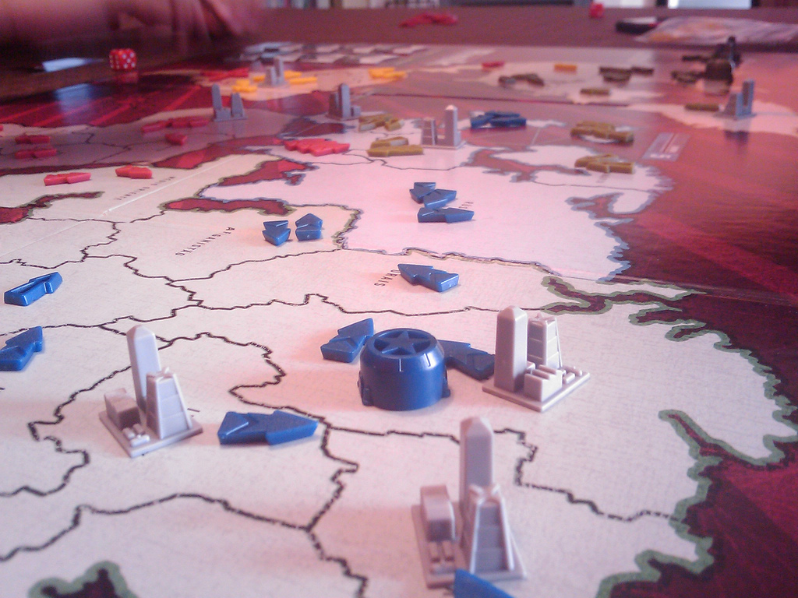
Pick a Jurisdiction
Image CC BY-SA-NC http://www.flickr.com/photos/nunonunes/

Slide 22
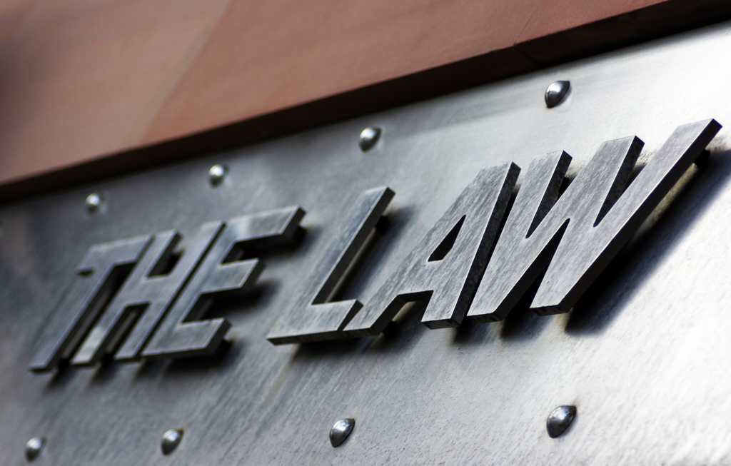
Pick a Type of Law
Image CC BY http://www.flickr.com/photos/biscuitsmlp/

Slide 23
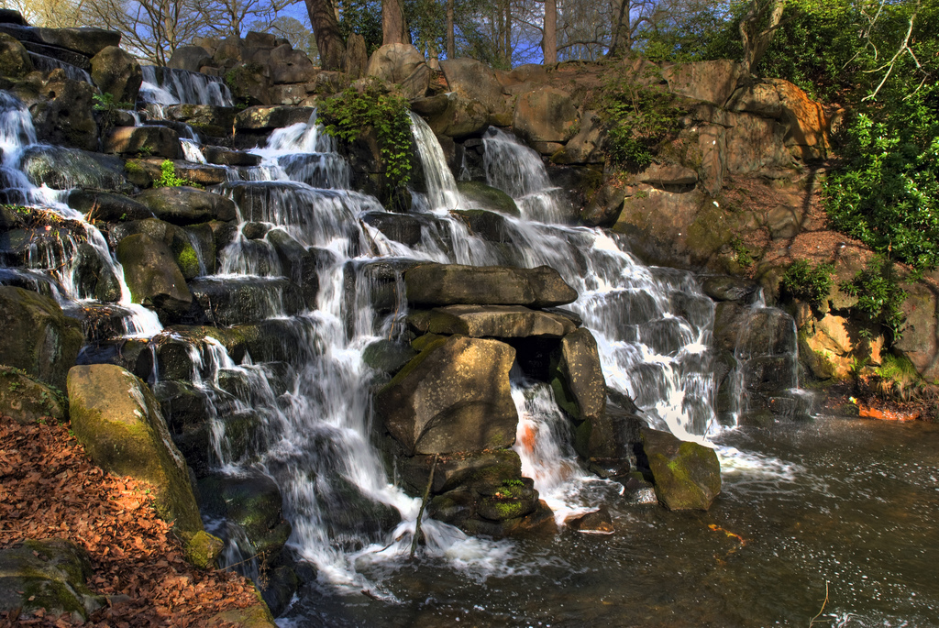
Find a Source
Image CC BY http://www.flickr.com/photos/ben124/

Slide 24
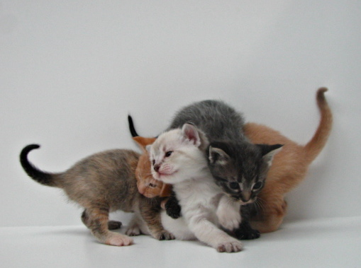
Choose Your Distribution Format
Image CC BY-NC-ND http://www.flickr.com/photos/ajoruss/
Notes:
Word docs, pdf, html, epub, api, rss..

Slide 25
Choose Your Distribution Mechanism
Image CC BY-NC http://www.flickr.com/photos/pulpolux/
Notes:
The Internet, obviously…but library website? Some other law school site? Classcaster? Internet Archive?

Slide 26
Congratulations!
You are now a distributer of Free Law!!!

Slide 27
WAIT…How Much is This Going to Cost???
Image CC BY-NC-ND http://www.flickr.com/photos/mellyjean/

Slide 28
Prepare to be inspired…
Examples of Law Schools Doing Free Law

Slide 29
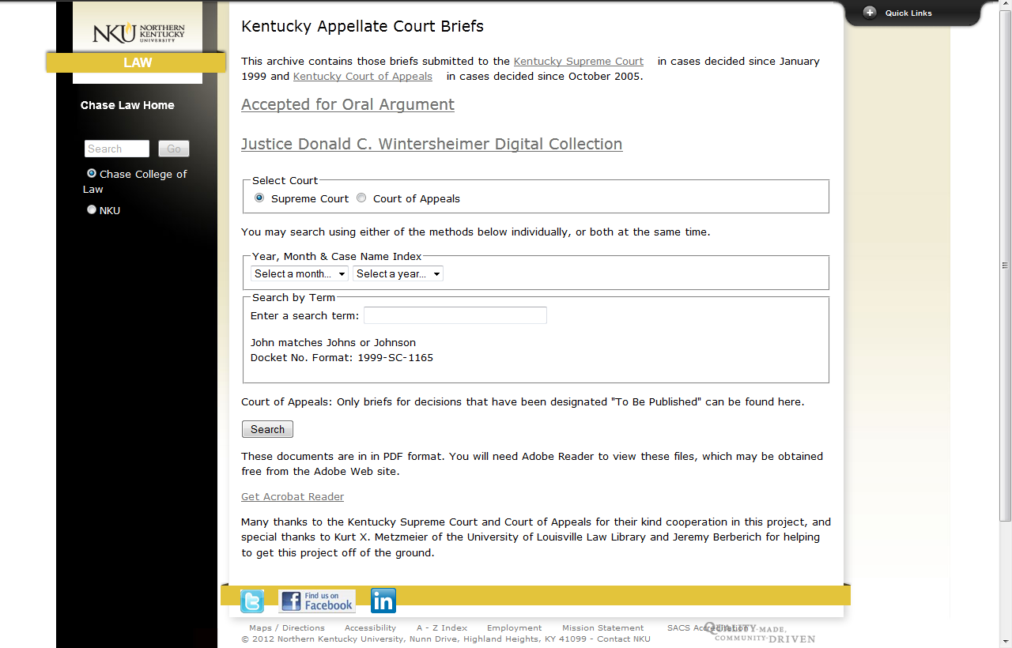
http://chaselaw.nku.edu/new/library/electronic_resources/briefs_search.php

Slide 30
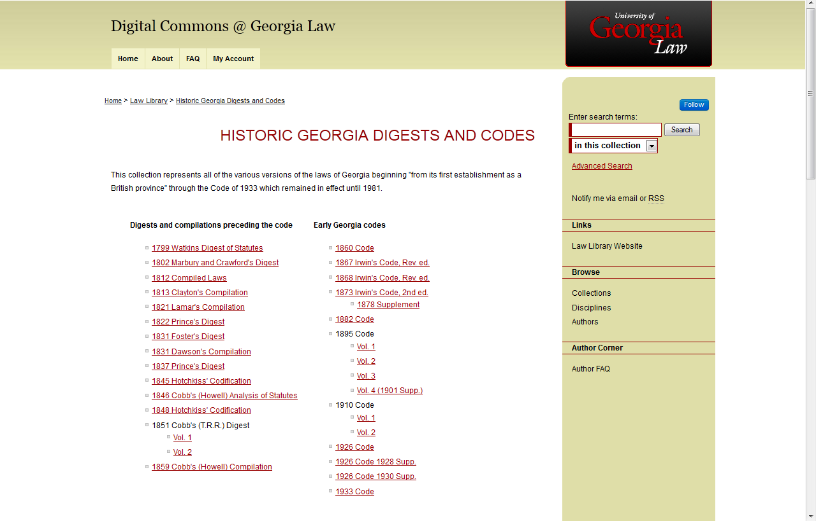
http://digitalcommons.law.uga.edu/ga_code/

Slide 31
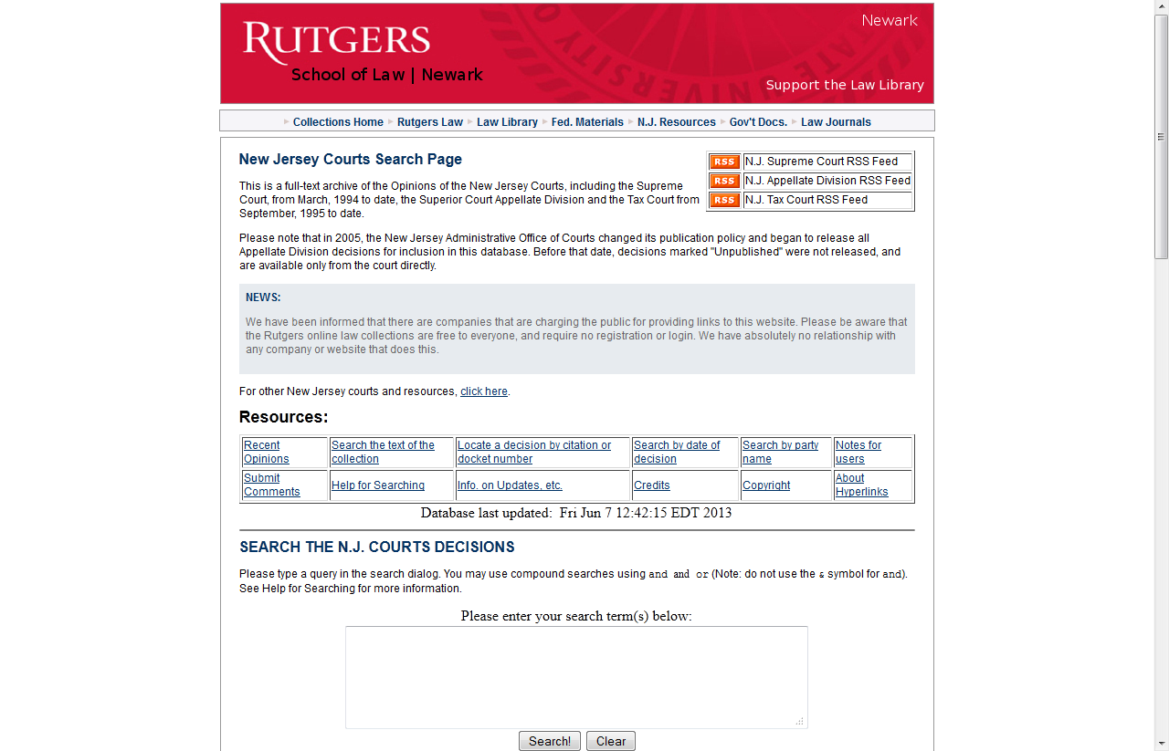
http://njlaw.rutgers.edu/collections/courts/

Slide 32
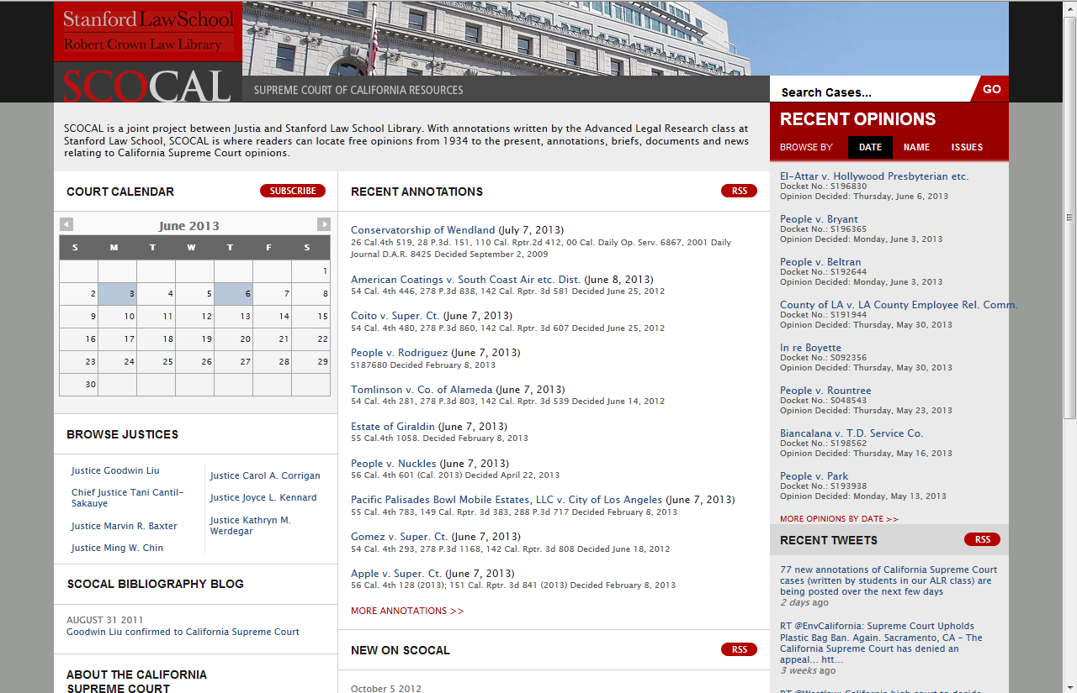
http://scocal.stanford.edu/

Slide 33
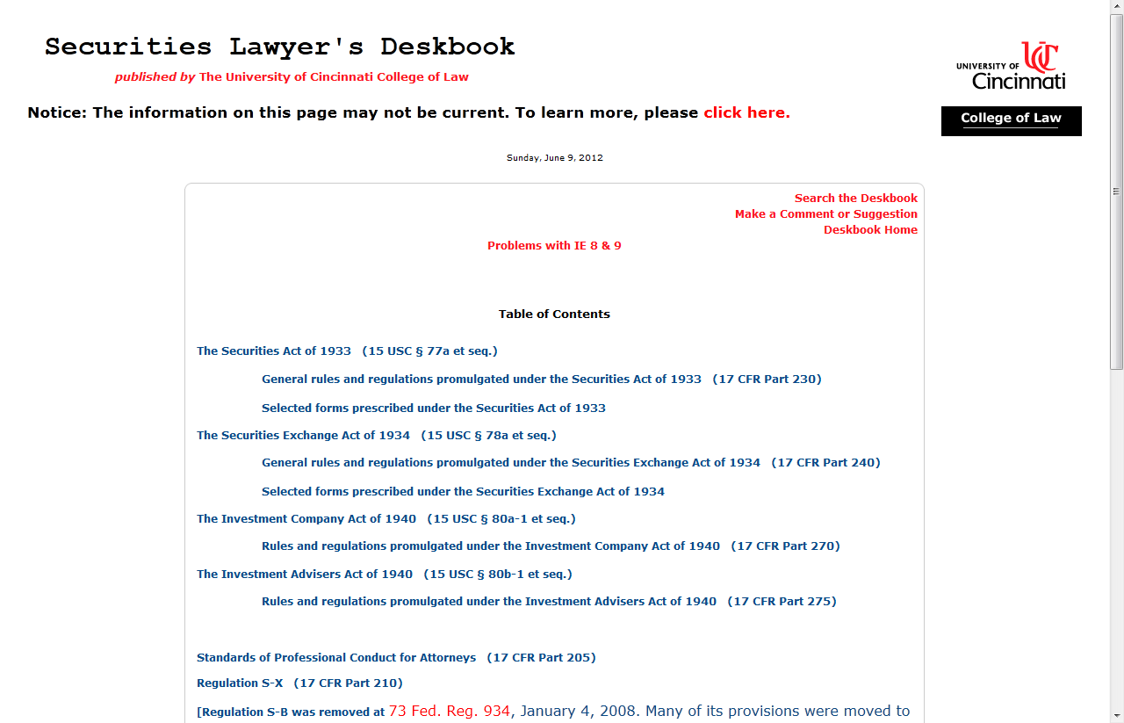
(Currently being updated with LII so no link)

Slide 34
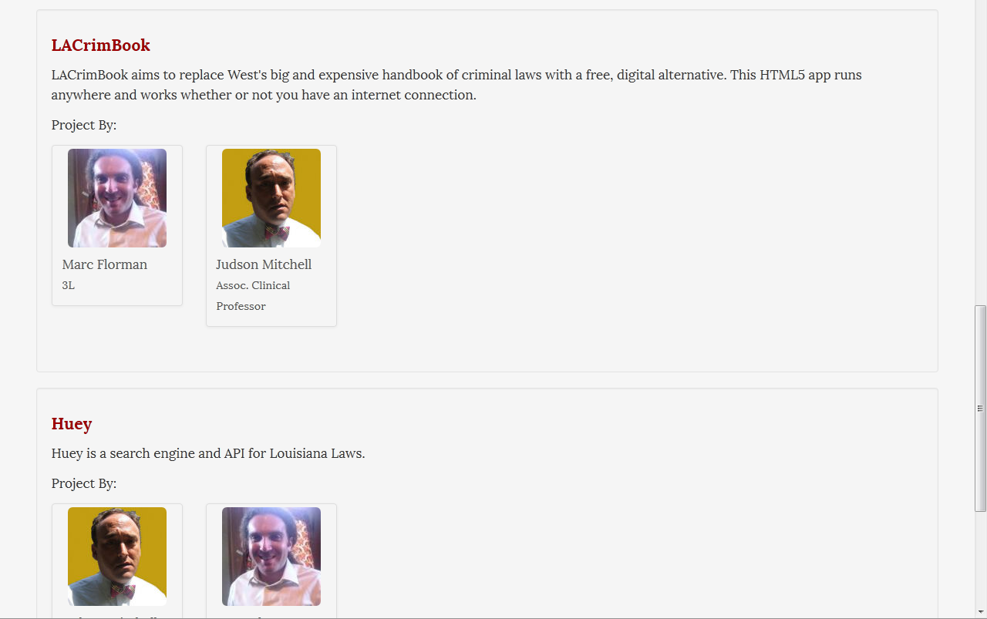
http://loyolalawtech.org/projects

Slide 35
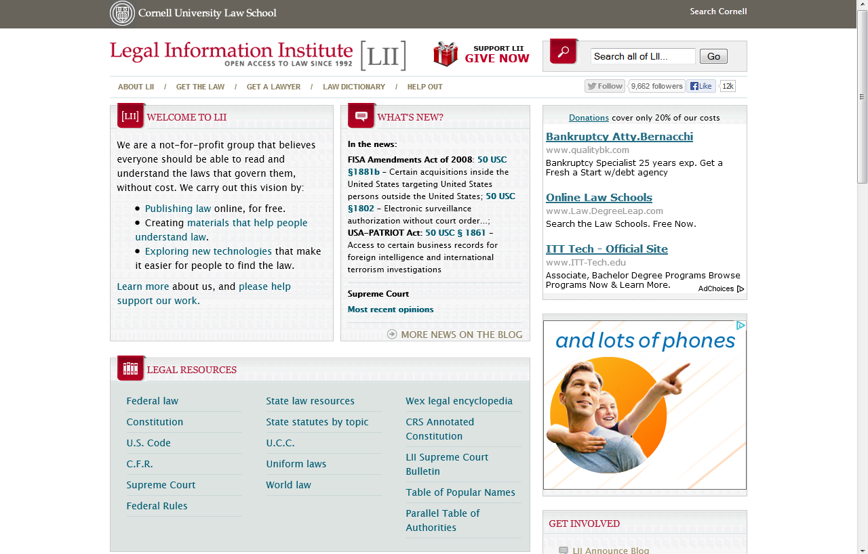
http://www.law.cornell.edu/

Slide 36
And now Elmer with some technological options and details…

