Slide 1
Some Free Law Fun Facts
Elmer Masters
CALI
emasters@cali.org
twitter.com/emasters

Slide 2
Some history
Once upon a time… http://cca.li/oJ
Emory - Fed Circuit, 1st, 4th, 6th, 10th, 11th
Georgetown - DC Circuit
Touro - 2nd
Pace - 2nd
Villanova - 3rd, still live at http://cca.li/oK
Chicago-Kent - 7th
Washington University St. Louis - 8th
Washburn - 10th
LII @ Cornell - SCOTUS

Slide 3

What happened?

Slide 4
Should academic law libraries be collecting and archiving primary legal materials?

Slide 5
Should academic law libraries be collecting and archiving primary legal materials in electronic formats?

Slide 6
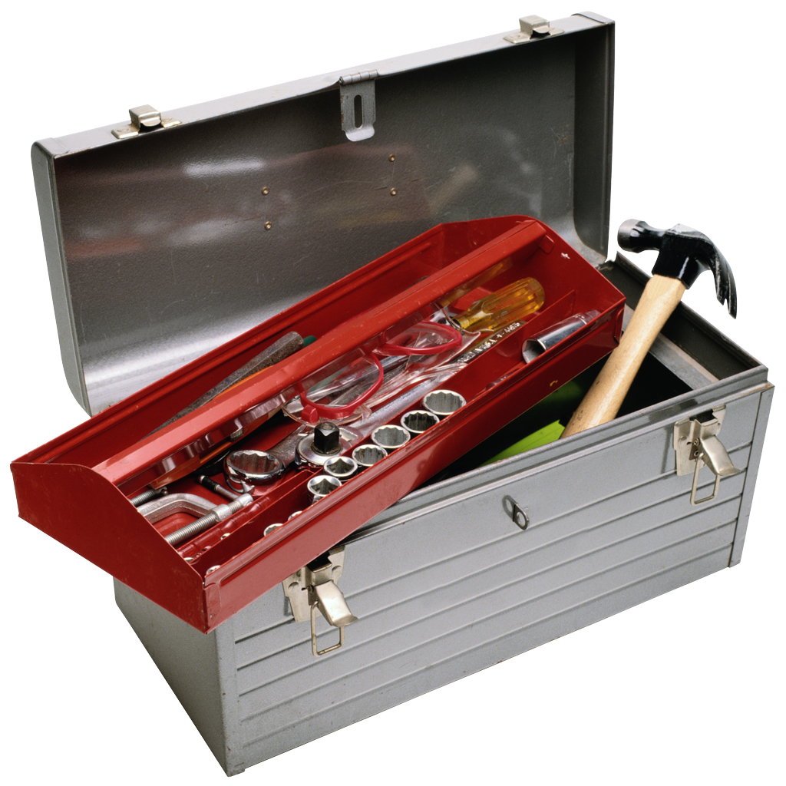
Would some tools help?

Slide 7
CALI has…
CourtCloud - www.courtcloud.org
  http://cca.li/oL for background
Free Law Reporter - www.freelawreporter.org
hackthelaw.lan - http://cca.li/lV

Slide 8
Homework
Go back to work and start a collection.
  Really.
  Pick some primary law, get a hard drive and go for it.
Questions?
  Email: emasters@cali.org

