Slide 1
Optimizing Drupal for Speed and SEO
Notes:
If you came to my talk last year, you saw this slide and we talked about methods you can use to speed up your Drupal site and optimize it for SEO.
After watching my video back I realized I missed something in my talk that’s pretty important these days when optimizing your site. Once you have your site optimized so it loads quickly, and optimized for SEO so that people actually come to your site, you want to keep those users engaged and keep them coming back, as well as encouraging them to spread the word about your site to bring you even more new users.
As such I thought I would update the talk to talk about social media. I also wanted to take the same optimization methods and talk about another popular CMS, Wordpress, so I give you [CLICK]

Slide 2
Optimizing Drupal and Wordpress
for Speed, SEO and Social Media
Nicholas Moline
Justia.com Senior Software Engineer
http://www.nick.pro/
@nickmoline
http://www.facebook.com/nickmoline
http://g.nick.pro/
Notes:
Second Stage Booster: Optimizing Drupal and Wordpress for Speed, SEO and Social Media.
My name is Nicholas Moline and I am a senior software engineer for Justia.com You can find more about me at my blog

Slide 3
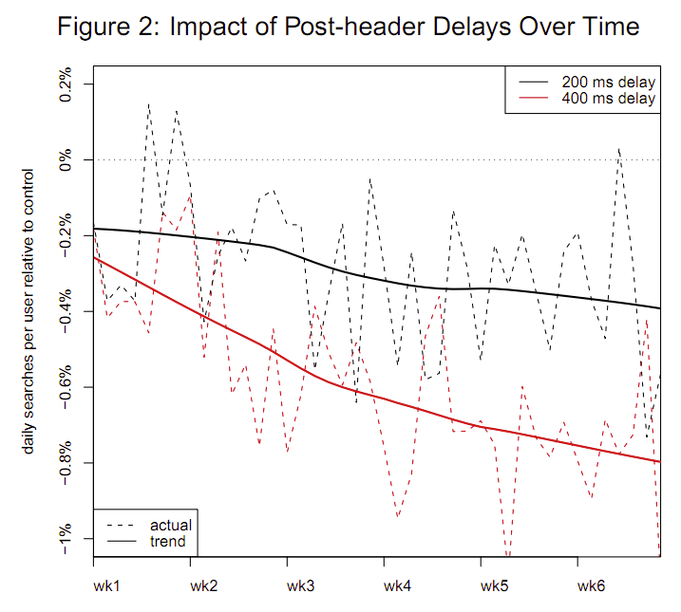
Why speed Matters
Users will get frustrated and not use you
Saves Money
SEO
Why SEO Matters
Users want to use Google, not your site search!
Notes:
Quick review. I showed this slide last year, why does Speed Matter? [CLICK and wait for point to come across]
I mentioned last year that Google used their A/B testing methods to see what effect delays had in the activity of people searching. Introducing a 200 milisecond delay, they found that people did an average of .3 less searches over the 5 week survey. People who had a 400 ms delay (less than half a second) did .6% fewer searches
Why care about less than 1%? From 200ms to 400ms delay, again, less than half a second, the percentage doubled, imagine how much worse it can get if you have 1 or 2 second delays.
What’s more, Google’s research showed that the longer you are exposed to these delays, the fewer searches you do on average. [SHOW GRAPH] The black line is 200 ms delay, the red line is 400 ms delay.
[CLICK]
Speeding up the site itself can save money as the faster your site performs and with the least amount of processing power, the less hardware you need to throw at it to keep it running.
[CLICK]
Because speed effects user engagement and slower speed pisses people off, the major search engines including Google and Bing have announced that they are going to take your site’s performance into consideration when it comes to how well your site ranks.
[Click] Why does SEO matter for a law school where you figure you have a captive audience?
[Click] Your users don’t want to use your site search, they want to use Google.

Slide 4
Drupal SEO/Speed Module Review
Speed
Caching
Boost
Varnish
Memcache API
APC or xCache
Minification
CSS Gzip
Javascript Aggregator
SEO
SEO Tools
Pathauto
Path Redirect
Global Redirect
Nodewords (D6)
Metatag (D7)
Page Title
XML Sitemap
Notes:
Speed and SEO modules for Drupal haven’t really changed much since I presented last year
On the speed side [CLICK], here are the modules that I am aware of that help with speed.
Boost works best in single server environments, if you are running multiple instances, you are better off with Varnish and Memcache which work better with multiple instances. Note with Varnish you will either need to do some core hacks or you will have to use Pressflow pre-optimized version of Drupal
In addition to speeding up Drupal itself, you really should speed up all the other files that come with it, the CSS Gzip and Javascript Aggregator modules will make the javascript and CSS files much smaller and will make them require far less round trips, really speeding up how your page is rendered in the browser.
On the SEO side [CLICK]
We have the drupal staple Pathauto, but you can’t just use Pathauto, you absolutely must have Global Redirect or you are going to be hit with a Duplicate Content penalty when there are multiple ways to get to your content. We also need to be able to control meta tags and title tags, so the Page Title and Nodewords modules are SEO essentials on Drupal. And the XML Sitemap module helps get your content into Google and other search engines as fast as possible, because rather than waiting for spiders to find your new content, you tell the search engines exactly where to find it and when it is updated.
Rather than use my checklist here though, there is a module (right on top) which itself IS a checklist of other modules and helps them connect together, grab the SEO Tools module from Drupal.org and it will guide you the rest of the way.

Slide 5
Why Social Media Matters
Keeps users coming back
Generates Traffic as users share your content
Increases SEO as Search Engines become more social
Social Networks may move into Search
People are Social

Slide 6
Social Drupal
Auto Sharing
User Sharing (Links)
Drupal for Facebook
Facebook Publish
Twitter
No Google+ available because no API
BONUS: ShURLy
Social Media
AddThis
ShareThis
Lockerz AddToAny
Disqus for Comments
Notes:
Ok Social Media modules for Drupal, here we go.
I basically break this down into 2 sub-groups, things that help you share your content as you create it [CLICK] and things that help your users share your content [CLICK]
On the Auto Sharing Side:
[CLICK] Drupal for Facebook actually is a building block module for helping you build a fully fledged Facebook app in drupal, it lets you expose contents into canvas pages on Facebook, and helps with various integration points like Facebook connect which lets you and your users log in using Facebook, and publishing your content to Facebook streams both on pages and profiles.
A Little simpler would be the [CLICK] Facebook Publish module which requires less work to setup and just publishes your new content to facebook. It requires the FBOauth module to have the Facebook Connect integration.
[CLICK] The module called simply Twitter, which is at drupal.org/project/twitter (it oddly doesn’t seem to come up in the module search when you search for twitter) is the simplest module I’ve found for auto-tweeting your content. It lets you and your users log into your site using Twitter logins, and it lets you auto-tweet your content both on a site wide twitter account (or accounts), as well as each user can connect their own twitter account, and when they create content their posts can be tweeted as well.
[CLICK] Google hasn’t released an API for posting to Google+ so there aren’t any plugins that will do this for you. If you care about posting your content to Google+, you’ll have to do it by hand, at least until next week at Google I/O where hopefully Google will release a new API and this can change.
On the User Sharing side
I’m a big fan of the one module to rule them all technique. Rather than a separate module for each share button (Which becomes klunky to theme) pick a module that provides all your share buttons at once, like the Social Media module [CLICK], or one of the ones that uses a service like [CLICK] AddThis, ShareThis or AddToAny.
A little bonus on this side, if you want to take comments from people who don’t have user accounts, rather than using Drupal’s rather limited commenting system, [CLICK] use Disqus which will let the users sign in using a large variety of social services, and has great spam protection.
Little bonus Social media plugin for Drupal that I like, ShURLy created by Lulabot. If you want your own custom URL shortener with really short urls that you fully control, ShURLy does a great job of turning drupal into a url shortening service. The only catch is that I recommend you put this on it’s own copy of Drupal, and then use the Shortlinks plugin from your main drupal installation. It’s fast to setup, fast to use, and it lets you get super short urls for tweeting, you’ll have to find a good domain name though.

Slide 7
Wordpress Caching for SPEED
WP Super Cache
W3 Total Cache
Batcache
WP-Cache
WP Simple Cache
DB Cache Reloaded Fix
Notes:
There are several cache plugins for Wordpress, tons actually, here are just a few of them [CLICK]
WP Super Cache is really simple to install, and if you only have a single server it works pretty well, Batcache is a memcache based cache, I’ve heard people say it works well, but it is a bit simple. DB Cache Reloaded Fix (what a name) is basically an enhancement to the Database based caches that Wordpress has core.
The one module here that really stands out though is W3 Total Cache. It has tons of different caches and accelerations for Wordpress including minification and gzipping, as well as a bunch of general speed optimizations, plus multiple configurable cache systems for the pages (File, memcache, php opcode caches) and everything can be configured separately. It also has support for various CDNs for speeding up access to your uploaded files. It can be a chore to get up and running, but I recommend it above the rest. Mashable uses this one themselves

Slide 8
Wordpress SEO
All in One SEO Pack
Wordpress SEO
Notes:
Like caching, the Wordpress community loves creating SEO plugins, every time I look it seems like there’s a dozen more that have popped up. The two most popular and best ones however are All in One SEO Pack and Wordpress SEO by Yoast.
Of the 2, I highly recommend [CLICK] Wordpress SEO by Yoast.
While the All in One SEO pack works great, it’s default options are kinda weird. For example the default options setup robots.txt blocking on all your category pages. Their theory is that your category pages are duplicate content, which is roughly true, but it’s still rediculous to block your category pages which tend to rank well for things like the name of the category.
Also the way the All in One SEO pack handles title tags is that it looks for any html <title> tag and rewrites it before output. This sounds simple, but it eliminates your ability to customize title tags in your theme if you want to.
The Wordpress SEO plugin gives you the option of rewriting titles or not, and its defaults make a lot more sense. As a bonus, it handles XML Sitemaps too right in the same plugin so you don’t need another one.
The Yoast plugin also gives you per post analysis of the SEO of your individual post, giving you good hints on how you can optimize it further.
Both plugins let you modify the title tags and meta tags of individual posts.

Slide 9
Social Wordpress
Auto Sharing
User Sharing (Links)
SFC Simple Facebook Connect
Facebook
STC Simple Twitter Connect
WordTwit Pro
GPAISR (Google Plus Author Information in Search Result)
SFC Simple Facebook Connect
Facebook
STC Simple Twitter Connect
Google Plus
AddThis / ShareThis / AddToAny
Disqus
Notes:
Like with Drupal let’s split this into Auto Sharing and User Sharing plugins.
Until about a week ago I would have told you the best plugin for auto-sharing to facebook (as well as allowing facebook logins for you) was a pack of plugins wrapped in a master plugin called Simple Facebook Connect [CLICK] or SFC.
Last week the landscape for Facebook sharing from wordpress changed a little bit when Facebook released their own wordpress plugin called simply [CLICK] Facebook. Now even the SFC authors recommend using the Facebook plugin instead
For posting to Twitter, the same people who made SFC made one called STC or [CLICK] Simple Twitter Connect. This does the job, but it is a bit limited on features, so we’ve found and like one called [CLICK] WordTwit Pro, which costs money but it is a much better plugin.
Now as I said with Drupal, there is no plugin for posting to Google+, however I strongly recommend that you integrate your author profile on your blog with Google+, one of the easiest ways to do this is with a plugin called CPAISR or the much longer name [CLICK] “Google Plus Author Information in Search Results” which simply replaces your link to your author profile on posts to a link to your google+ profile, this will allow your photo to show up when people see blog posts written by you, and it will appear as if you have shared all your posts (even though it won’t show up in your stream, it will show up on google search that way) which is good.
For users sharing your posts, this will look humorous but those plugins I mentione before, they kinda do this, so SFC, Facebook, STC all will optionally let you add Like and Tweet buttons to your content.
For Google Plus there’s a decent plugin that not only gives you +1 buttons on your posts, but also sets you up with some widgets for your sidebars for showing your Google Plus stream if you care about such things.
Like with Drupal the various services AddThis, ShareThis and AddToAny have their own plugins, and for wordpress especially I recommend replacing your built in comments with Disqus. You’ll spend less time moderating and your users will have a nice clean interface for commenting, and it can even auto-share their comments to twitter and facebook when they comment.

Slide 10
Optimizing Drupal and Wordpress
for Speed, SEO and Social Media
Nicholas Moline
Justia.com Senior Software Engineer
http://www.nick.pro/
@nickmoline
http://www.facebook.com/nickmoline
http://g.nick.pro/
Notes:
Second Stage Booster: Optimizing Drupal and Wordpress for Speed, SEO and Social Media.
My name is Nicholas Moline and I am a senior software engineer for Justia.com You can find more about me at my blog

