Slide 1
Video and the School of Law: Distance Learning, Video Conferencing and Live Event Delivery
Thursday, June 24, 2010 @ 4:00pm (103)
Phillip Bohl, Director of Information Services
David Dickens, Consulting Technologist & System Architect

Slide 2
Part 1: Summary
The most successful technology projects incrementally improve the established pedagogical and business processes of the law school while incorporating substantial future developments of those processes.
That's fancy speak for, Make sure your project makes things better for people out of the gate and then unveil the more dramatic changes once you've proven it's a good idea.
Pepperdine School of Law has been evolving our delivery of video in several different dimensions over the last few years. Now we've laid the platform for some emergent possibilities. This presentation will discuss what we've done and what we're dreaming of doing.

Slide 3
Incrementalism
Incremental improvements over time can (should) come together to complete a larger project and provide innovation which otherwise might not get funded or be considered valuable by the institution in parts.

Slide 4
Is This Sneaky?
No. It’s providing incremental value to the institution while keeping the larger goals in mind.
OR …

Slide 5
Yes!
It is sneaky

Slide 6
Building, Budget and Background

Slide 7
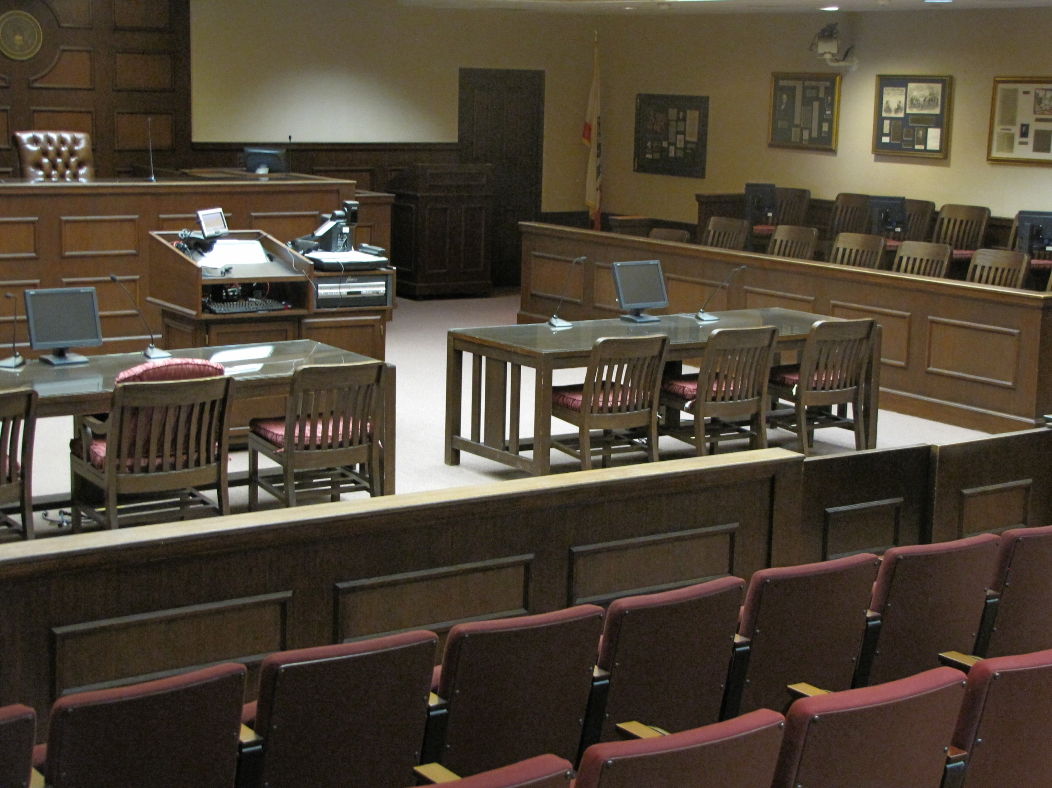
Section 1: Background

Slide 8
Section 2: Budget
Annual funding vs. One-time funding and taking advantage of events, special projects and sweat equity to drive budget innovation

Slide 9
Hitching a Ride
Landis Arbitration London Campus Network Wireless Upgrade MACR build Digital Signage Grant ERP/New Copper
Nobel Laureate Muhammad Yunus
Supreme Court Symposium (linked to National Constitution Center)

Slide 10
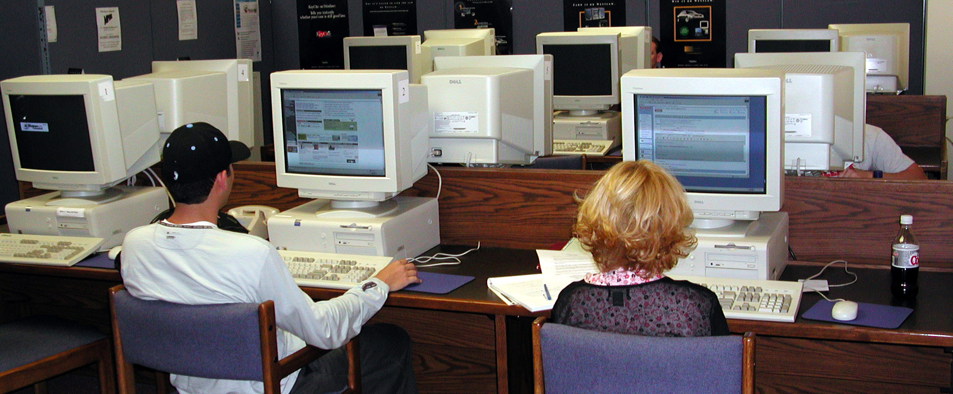
Section 3: Building Remembering
(the way we were … )

Slide 11
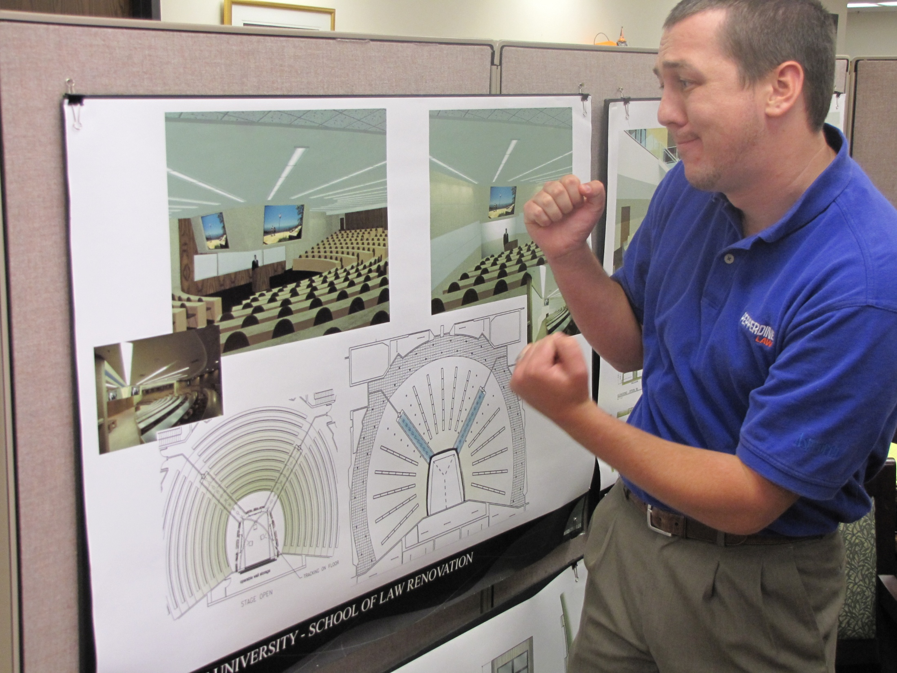
Section 3: Building Dreaming

Slide 12
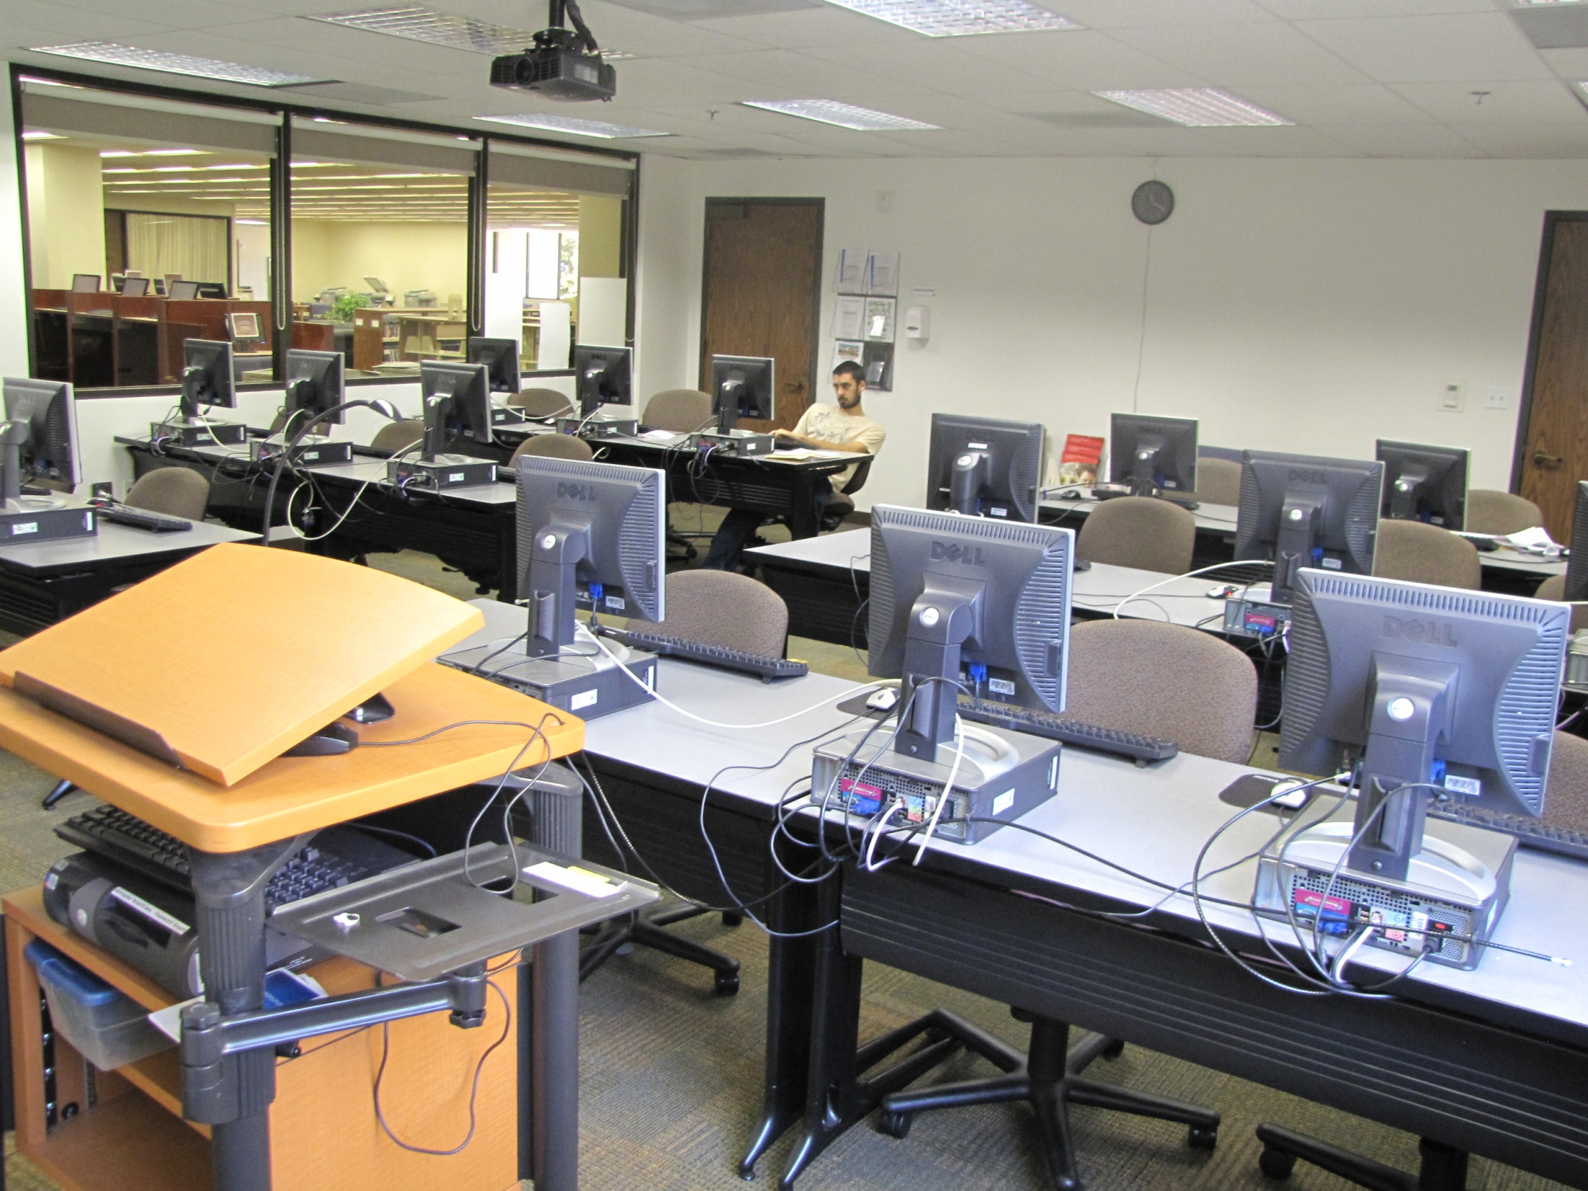
Section 3: Building Reality

Slide 13
The Needs
Video Distribution:
Conferencing,
Recording, and
Event Broadcasting
A Platform for Innovation

Slide 14
Part 2: Video Going Forward
Making different technologies taste great together.

Slide 15
Section 1: First Moves
Or, “What we had done with Geffen, duct tape and bailing wire.”

Slide 16
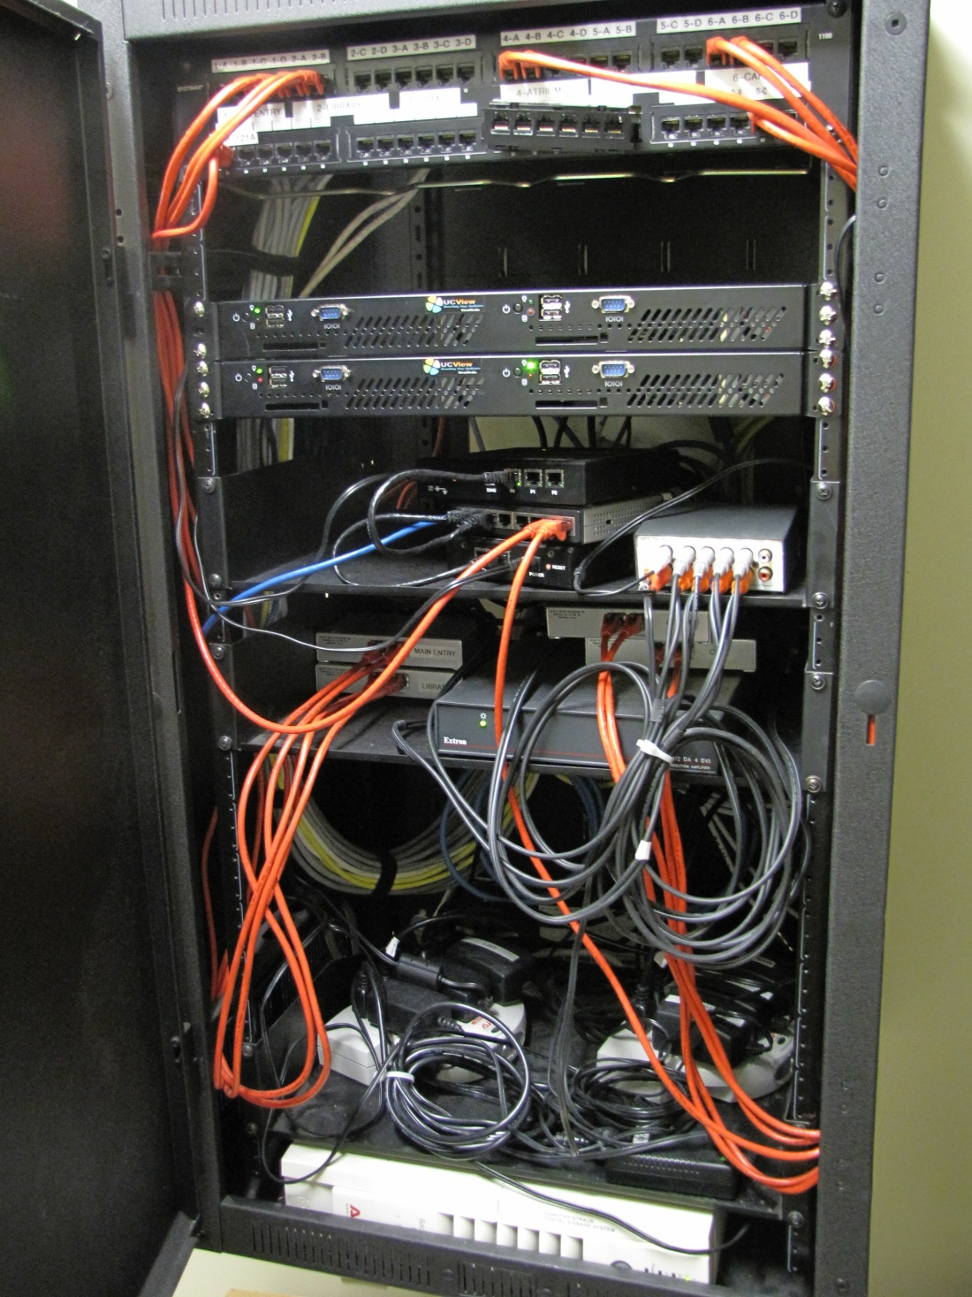
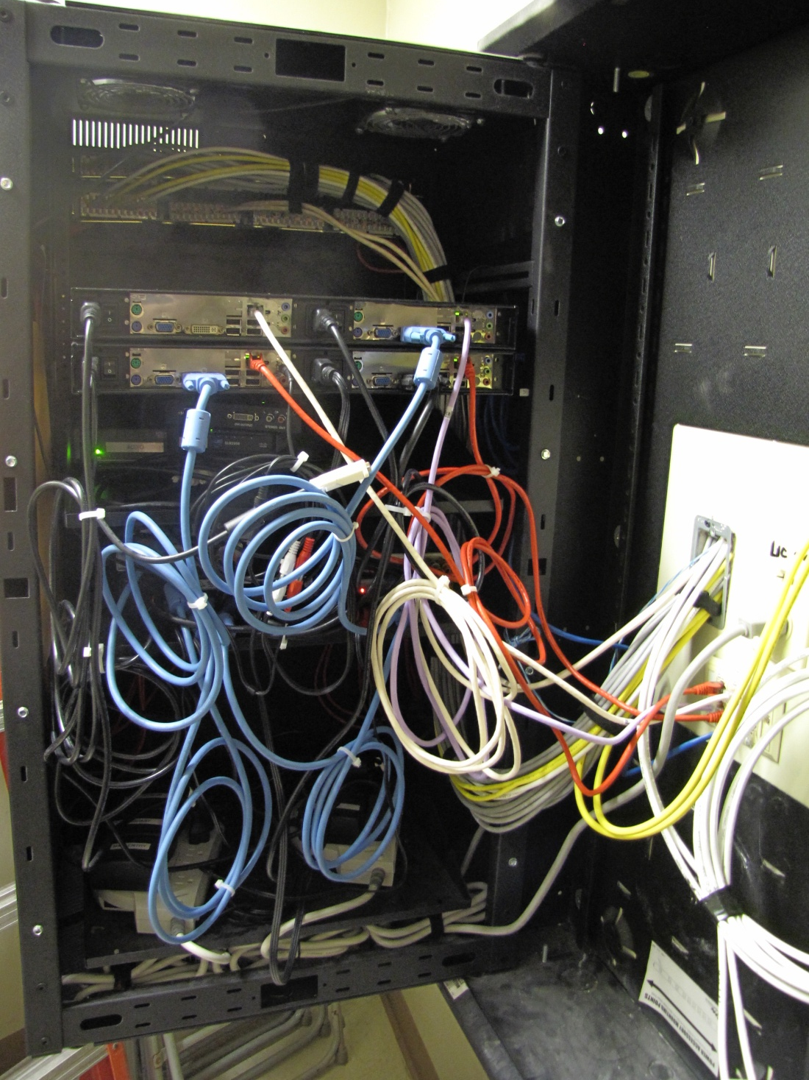
Digital Signage

Slide 17
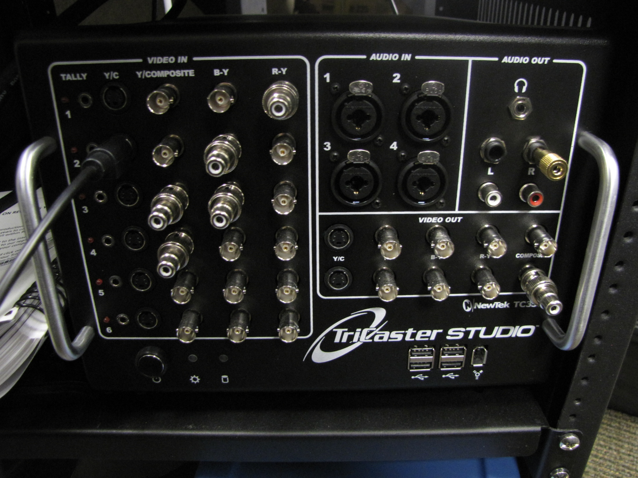
Tricaster

Slide 18
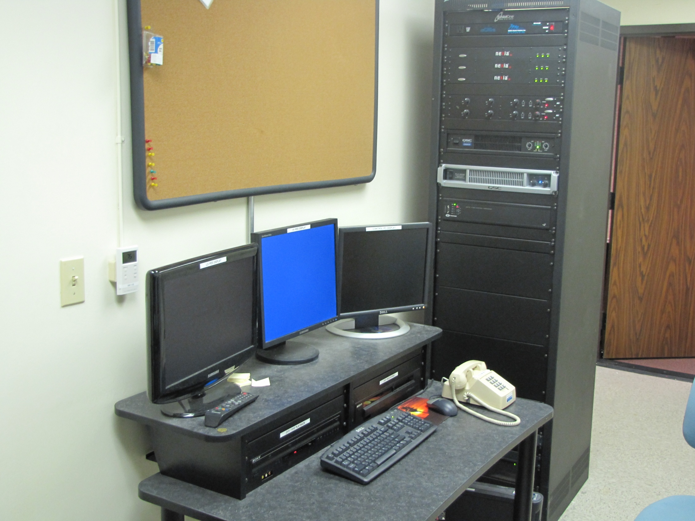
Section 2: Putting the Pieces in Place Mendenhall Appellate Court Room

Slide 19
Skype vs. Polycom
VS.

Slide 20
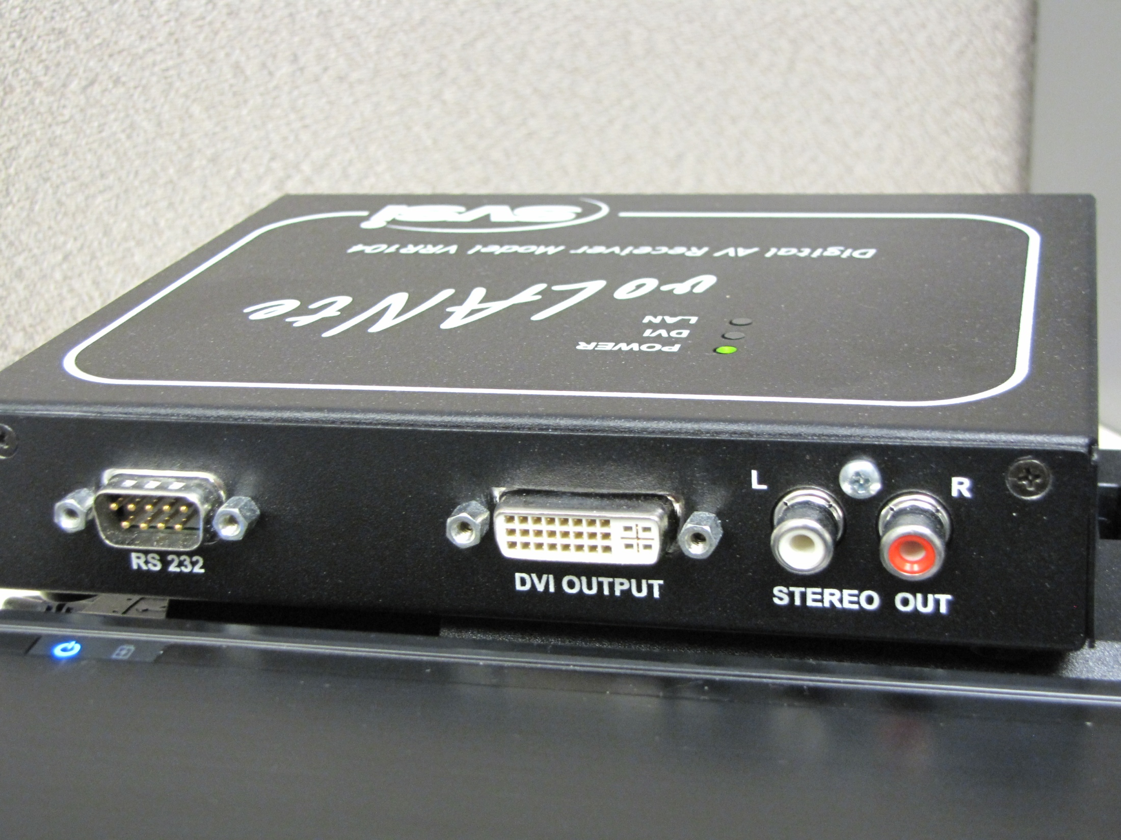
SVSI and voLANte

Slide 21
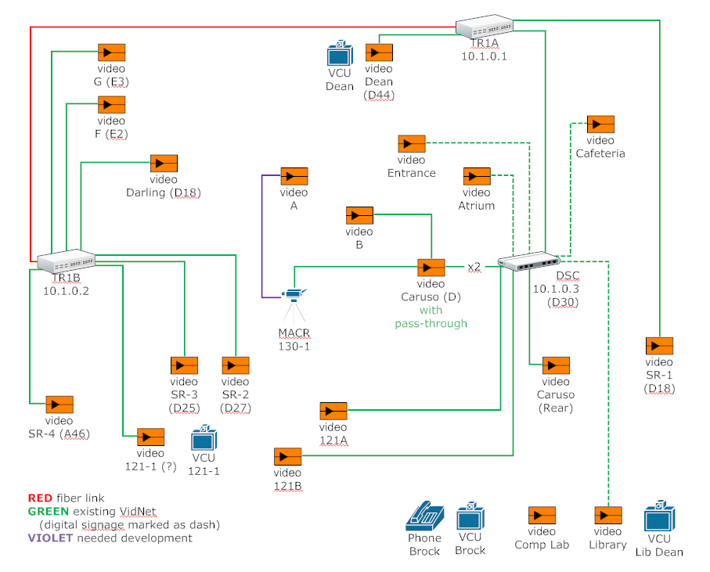
Video Network Diagram

Slide 22
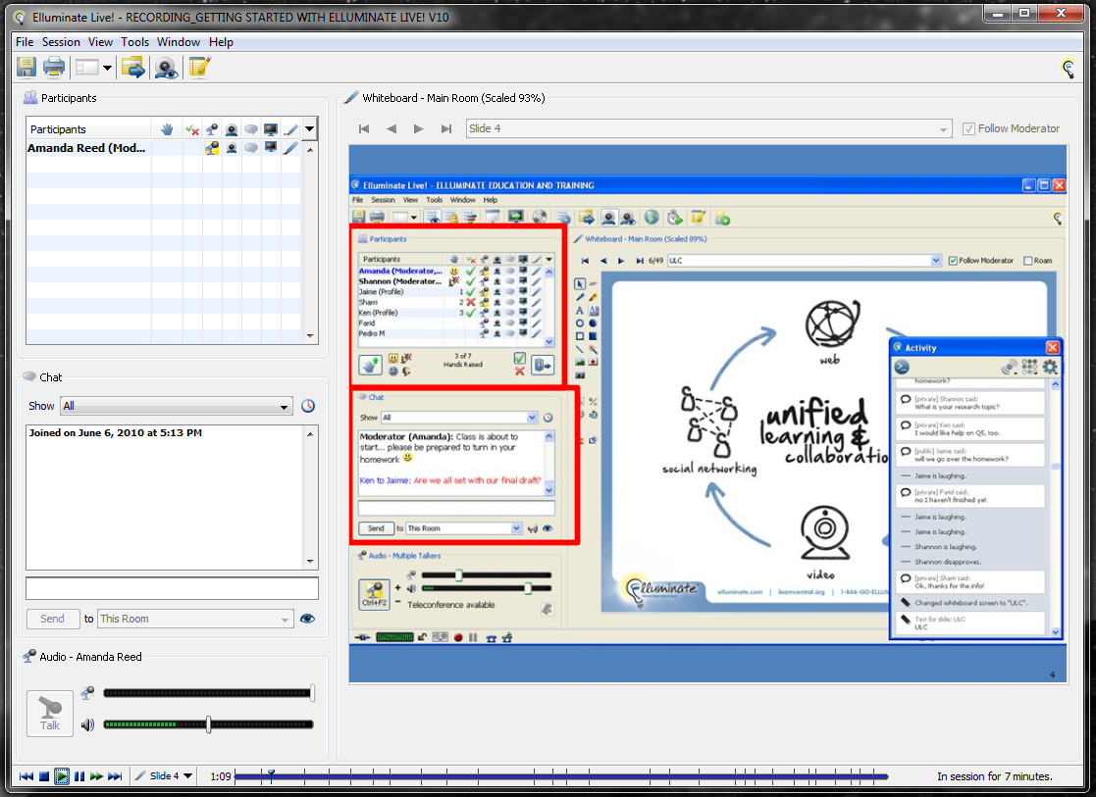
Elluminate

Slide 23
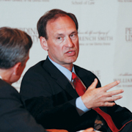
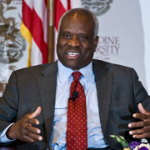
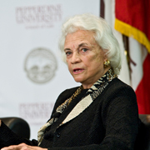
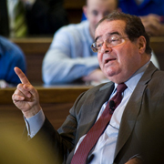
Section 3: Impressing People

Slide 24
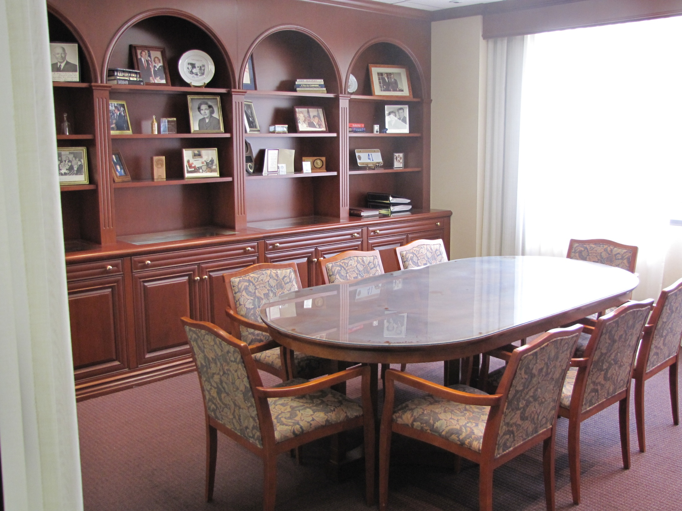
Brock Conference Room

Slide 25
Brock Conference Room Part 2
caught on camera

Slide 26
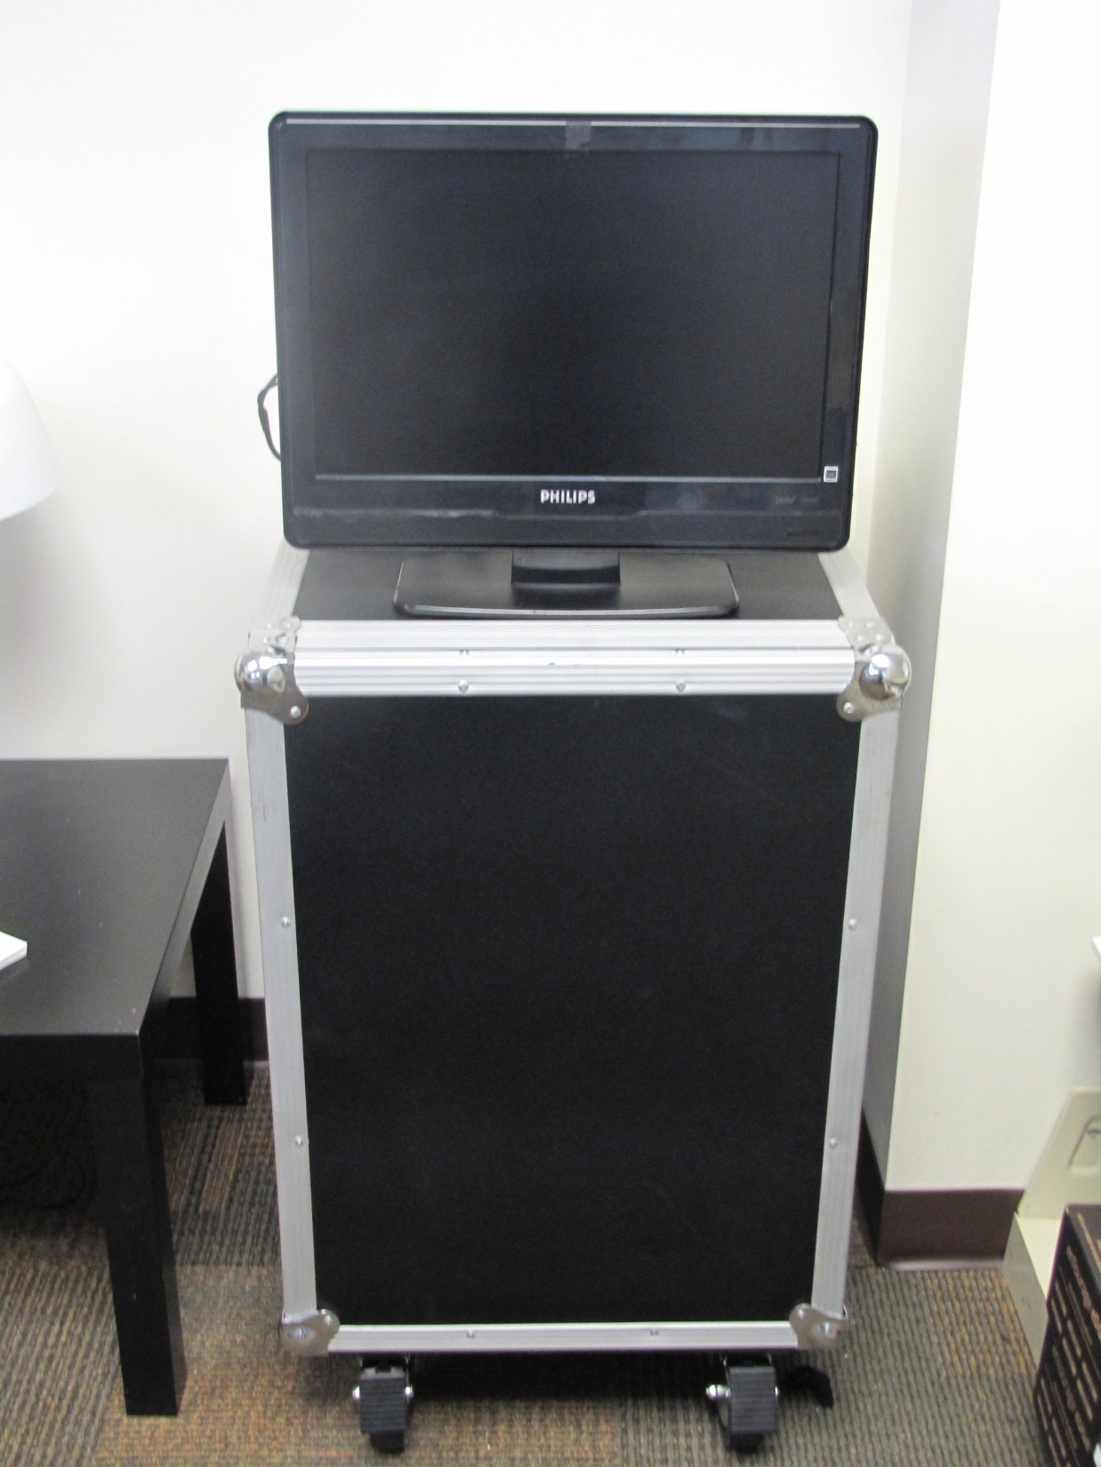
The Box

Slide 27
Section 4: The Plan(tm)

Slide 28
All DVI, all the time.
There’s more to it than that.

Slide 29
The Risk

Slide 30
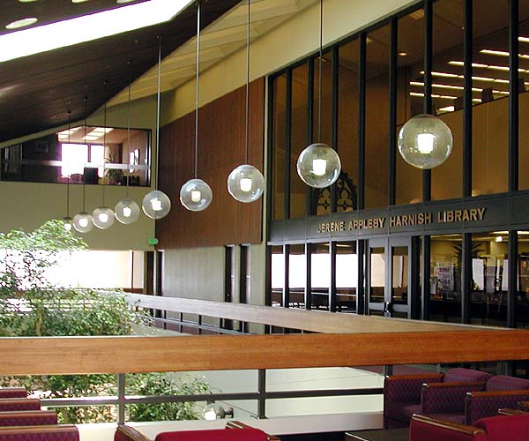
Part 3: Questions and Answers

